Slide 1
Socio-Economics Inspired Distributed Systems Design
David Hales
www.davidhales.com
The Open University, UK
Design Group Seminar, Nov. 16th, 2011

Slide 2

Peer-to-Peer (P2P) is not a technology.
It is a (design?) philosophy.
It runs something like this:
Distributed systems are inherently more efficient, robust and responsive to user needs if functionality, where possible, is decentralized. This means that central control, hierarchy and concentration of resources should be avoided, while peer-level coordination should be encouraged.

Slide 3
What are peer-to-peer systems?
Machines (nodes) on the internet
Dynamically connecting to a few others
Cooperating to achieve some task
So-called “overlay networks”
Majority of internet bandwidth use is P2P today
Often associated with illegal copying

Slide 4
Popular applications of P2P
BitTorrent
Open protocol for sharing large files
Peers cooperate to speedup downloads
Skype
Closed protocol for voice over IP
Peers cooperate to route audio streams
Bitcoin
Open protocol for making payments in virtual currency
Peers cooperate to improve security

Slide 5
Big Picture
P2P can mean “person-to-person” (less technology more person emphasis)
Social science and economics can inform the design of P2P systems
P2P systems change economic realities
New economic models (commons-based peer production – “wealth of networks” by Yochai Benkler)

Slide 6
Big Picture
What is important?
Increasingly these technologies will structure our social interactions
When we design them we make social and economic choices
We should be aware of these to inform “good design”
Design such systems for the common good?
What is the common good?
How do we design systems for the common good?

Slide 7
What has sociology or economics got to do with peer-to-peer systems?
P2P systems are socio-economic systems
Peers cooperate collectively to achieve their goals
No peer in the system controls everything
Performance results from interactions
At the end-of-day users (people) are in control
Sociology and economics has studied such phenomena and systems design benefits from this

Slide 8
OK but what use is this to me?
Knowing some of the economic background should help you to understand:
the basic social/economic theory behind P2P
how this informs designs
how such designs might be improved
how to assess new developments and designs
It is also a fascinating area in itself:
If you are interested you can look-up the terms given in red italics on Wikipedia for good introductions

Slide 9
Individualism v. Collectivism
In socio-economic systems individual interests may conflict with collective interests:
e.g. over exploitation of a common resource (a river, a field, the atmosphere etc.)
e.g. banks - lending (to those who they know can not repay) to gain a commission by selling on the debt to other banks
e.g. P2P file sharing system - downloading more than uploading

Slide 10
Individualism v. Collectivism
Consider a P2P file sharing system:
It is in the collective interest for all to upload to others so everyone gets the file quickly
But it is in the individual interest to save bandwidth by only downloading and hence free-riding on others
Free-riding (or free-loading) is a perennial problem in P2P file-sharing systems
Any efficient system needs to tackle it in some way

Slide 11
The tragedy of the commons
These kinds of situations have been termed “commons dilemmas” or “common pool resource dilemmas”
Called “dilemmas” because we would all be better off if we “did the right thing” but there is an individual incentive to do the wrong thing
G. Hardin (1968) summarized the issue in his famous paper: “The Tragedy of the Commons”
These kinds of situations occur in P2P file-sharing systems like BitTorrent

Slide 12
How to avoid the commons tragedy?
Central enforcement of correct behaviour
require centralised agencies and policing
ability to identify and track individuals centrally
not suitable for pure P2P (but used with private trackers)
Decentralised methods
self-policing producing incentives for cooperation
do not require centralised coordination
more suitable for pure P2P
can apply ideas from “game theory”

Slide 13
What is game theory?
A way to mathematically analyse games assuming we know:
number of players
possible moves they can make (strategies)
outcome of game based on players moves (pay-off)
desirability of game outcomes for each player (utility)

Slide 14
What game are you playing?
Games can be categorised into two types:
Zero-sum games
when one player wins another loses
summing the final utilities of players = 0
e.g. poker, chess, monopoly etc.
2) Non-zero-sum games
utilities do not always sum to zero
both players may lose or both may win
considered to capture social / economic realities
e.g. tragedy of the commons examples

Slide 15
Capturing a commons tragedy with a simple game
Consider a game composed of two players:
each player:
has choice of one move (C or D)
makes a single move then the game ends
does not know how the other will move
gets a payoff (or utility) based on how they moved and how the other player moved
for certain payoff values this game can, minimally, capture a form of commons tragedy (or dilemma)
a classic such game is called the Prisoner’s Dilemma

Slide 16
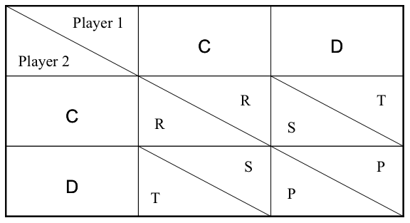
The Prisoner’s Dilemma - “payoff matrix”
Game is a PD when: T > R > P > S and 2R > T + S
(3)
(5)
(3)
(0)
(0)
(1)
(5)
(1)

Slide 17
The Prisoner's Dilemma - example games
Players => |  | P1 | P2 |  | P1 | P2 |  | P1 | P2 |  | P1 | P2
Moves => |  | C | C |  | C | D |  | D | C |  | D | D
Payoffs => |  | R | R |  | S | T |  | T | S |  | P | P
Values => |  | 3 | 3 |  | 0 | 5 |  | 5 | 0 |  | 1 | 1
Total => |  | 6 |  |  | 5 |  |  | 5 |  |  | 2
A contradiction between collective and individual interests

Slide 18
Game theory says defect!
Game theory assumes players are:
rational - attempt to maximise their utility
selfish - don’t care about the other guy
knowledgeable - have complete information
clever - have unlimited computational time
Given these assumptions it can be proved:
agents will select equilibria where no player will improve by changing strategy unilaterally
many games have such equilibria - by the famous John Nash (so-called Nash Equilibrium - NE)
the NE for the PD is DD (all defect)

Slide 19
Iterated Prisoner’s Dilemma
Previous example “one-shot” PD but:
real world interactions often repeated
might meet the guy you just ripped-off in the future
allows for more complex sequence of strategies based on past interactions with others
can punish someone tomorrow for defecting against you today - “the shadow of the future”
Iterated PD (IPD) captures this and, as we will see, maps well onto P2P file-sharing protocols like BitTorrent

Slide 20
What is the rational thing to do in the IPD?
Traditional game theory has trouble here:
cooperative equilibria exist in infinitely repeated games but not in finite games of known length
many equilibria exist and it is not clear which one would be chosen by rational agents
In all cases defection on every round is still a equilibrium even when cooperative equilibria exist
For these reasons Robert Axelrod (political scientist), in the late 70’s, decided to find out what kinds of strategies worked well in the IPD by using computer simulation

Slide 21
Axelrod’s Tournament - programs as strategies
Axelrod organised an open IPD tournament:
Academics were asked to submit programs (BASIC or FORTRAN) that would play the IPD against each other
Nobody knew competitors code
The only input would be the on-going past history of the game (a string of C’s and D’s)
The aim was to get the highest score (utility) based on round-robin playoffs between all pairs of programs
Axelrod’s aim was to see which programs did best against all the others and understand why
He wrote-up his results in the famous book “the evolution of cooperation”

Slide 22
Axlerod’s Tournament - what happened?
Basic results were:
many strategies were submitted (complex and simple)
the one with the highest overall score turned out to be simple: tit-for-tat (TFT) or “look back”
starts playing C, then “looked back” at the last move made by opponent and copied that move
submitted by Psychologist Anatol Rapoport
didn’t “win” against each strategy but did better overall on average against all strategies
TFT mechanism an example of “reciprocal altruism” (Robert Trivers)

Slide 23
What has this got to do with BitTorrent?
In the BitTorrent protocol:
TFT-like method used for sharing files
nodes form groups interested in a particular file (swarms) and swap or “barter” pieces with each other
if a node does not upload data then this can be compared to playing defection
it is punished in the future by being “choked” - not getting upload from others
even if you hack your client to be selfish the chances are the standard TFT-like protocol will do better overall
Bram Cohen - original BT designer - inspired by Axelrod’s tournaments

Slide 24
Some BitTorrent Terminology
Swarm: set of peers interested in a file
file is split in smaller chunks called pieces
seeder: holds a full copy of the data
leecher: holds only a part of the data (initially nothing)
Tracker: centralized manager
keep track of all peers in the swarm
return list of current peers in swarm
Torrent file: meta-data
contains pointer to tracker hosting the swarm
details about the file - hash, no. of pieces, size etc.

Slide 25
BitTorrent Protocol
Get a list of other peers in the swarm from the tracker
Ask peers their list of pieces and tell them what is yours
Exchange pieces with appropriate peers

Slide 26
The Global Ecology of BitTorrent Clients
Many bittorrent clients exist in “the wild”
Bittorrent 6 (from Bittorrent.com, formally utorrent)
Others: Azureus, ABC, Transmission, many others…
bad guy clients: BitThief, BitTyrant
Hence:
The current bittorrent ecosystem is a global on-going experiment, like Axelrod’s, but with huge user base and rich interactions (not just TFT) incredible strategy sophistication
This is unprecedented and will surely lead to new economic theory - in general!

Slide 27
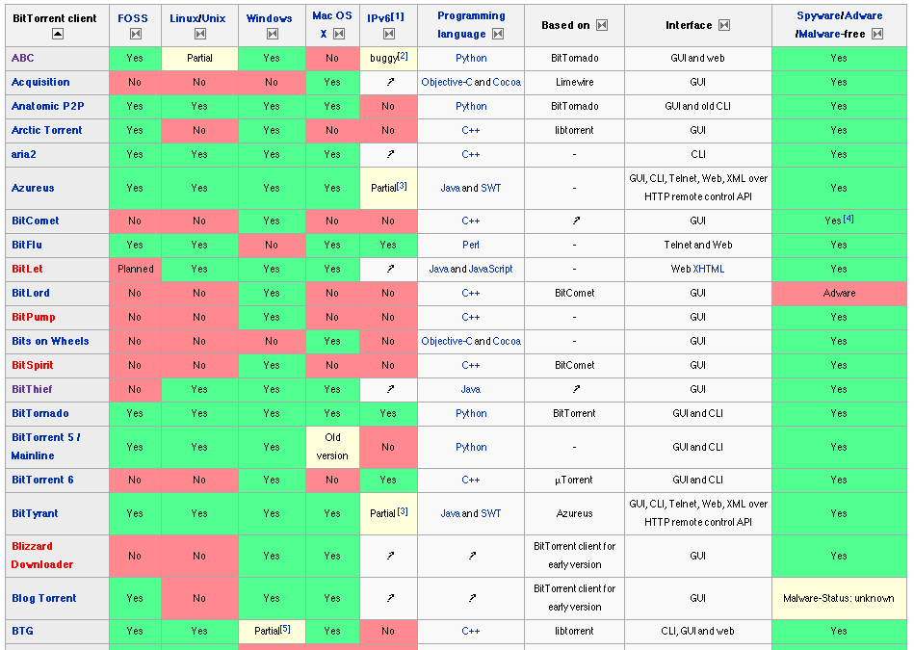
BitTorrent Clients

Slide 28
Take home message
Previous work in social / economic science (Axelrod’s IPD) has provided a basis for protocol design in a P2P system
Deployed variants of the protocol are creating a massive global economic experiment
Measurements can be made and these could inform new theory and new protocols

Slide 29
References
Nash, John (1950) Equilibrium points in n-person games. Proceedings of the National Academy of Sciences 36(1):48-49.
John von Neumann and Oskar Morgenstern: Theory of Games and Economic Behavior, Princeton University Press (1944)
Robert Axelrod (1984) The Evolution of Cooperation, Basic Books
Nowak, M.A. and Sigmund, K. (1998) Evolution of indirect reciprocity by image scoring, Nature 393, 573.
Garrett Hardin (1968) The Tragedy of the Commons Science 162, 1243-1248.
Trivers, R.L. (1971). The evolution of reciprocal altruism. Quarterly Review of Biology. 46: 35-57
Maynard Smith, J. (1982) Evolution and the Theory of Games. Cambridge University Press

Slide 30
work using socio-economic ideas
Effort based incentive approaches from participatory economics applied in BT
Rahman, R., Meulpolder, M., Hales, D., Pouwelse, J. and Sips, H. (2010) Improving Efficiency and Fairness in P2P Systems with Effort-Based Incentives. Proceedings of the IEEE International Conference on Communications, 23-27th May 2010, Cape Town, South Africa
Analysis of credit shortages and “monetary policy” in private BT communities
Hales, D., Rahman, R., Zhang, B., Meulpolder M., and Pouwelse, J. (2009) BitTorrent or BitCrunch: Evidence of a credit squeeze in BitTorrent? Proceedings of the 5th Collaborative Peer-to-Peer Systems (COPS) Workshop, in conjunction with 18th IEEE International Workshops on Enabling Technologies: Infrastructures for Collaborative Enterprises, June 29 - July 1, 2009, Groningen, the Netherlands.
Rahman, R. and Hales, D., Vinko, T., Pouwelse, J. and Sips, H. (2010). No more crash or crunch: sustainable credit dynamics in a P2P community. International Conference on High Performance Computing & Simulation (HPCS 2010), Caen, France, 2010.
Apply Axelrod-like tournaments to realistic BT protocol
Joint work with Rameez Rahman, Tamás Vinko, David Hales, Johan Pouwelse, Henk Sips (2011) Design Space Analysis for Modeling Incentives in Distributed Systems, to be presented at Sigcomm August 2011, Toronto.

Slide 31
Design Space Analysis for Modelling Incentives in Distributed Systems
Mainly thesis work of Rameez Rahman
Apply Axelrod-like tournament approach to evaluate realistic P2P protocol variants
Interesting bit is:
break down of P2P protocols into a design space
Evaluation of protocol variants (PRA)
Specific application to BitTorrent protocol variants

Slide 32
PRA characterisation of a protocol
Performance - the overall performance of the system when all peers execute Π (where performance is determined by the designer);
Robustness - the ability of a majority of the population executing Π to outperform a minority executing a protocol other than Π;
Aggressiveness - the ability of a minority of the population executing Π to outperform a majority executing a protocol other than Π.

Slide 33
More detail on PRA
P = average download time
R = number of “wins” in round robin tournaments against all other protocol variants
A = number of “wins” in round robin tournaments against all other protocol variants
P,R,A values normalised over the space

Slide 34
Parameterising a P2P protocol
Peer Discovery: In order to perform productive peer interactions, it is necessary to find other partners. For example, when a peer is new in the system, looking for better matching partners or existing partners are unresponsive. The timing and nature of the peer discovery policy are the important aspects of this dimension.
Stranger Policy: When interacting with an unknown peer (stranger), past history cannot be used to inform actions. It is therefore necessary to apply a policy to deal with strangers. The way peers allocate resources to strangers is an important aspect of this dimension.
Selection Function: When a peer requires interaction with others this function determines which of the known peers should be selected. This could include, for example, past behaviour (through direct experience or reputation system), service availability and liveness criteria.
Resource Allocation: During peer interactions resources must be allocated to the selected peers (given by the selection function). The way a peer divides its resources among the selected peers, defines the resource allocation policy.

Slide 35
Parameterising BT
Stranger policy (10 variants)
Selection function:
Candidate list - peers to consider (2 variants)
Ranking function - order list (6 variants)
Selection - number of peers to select (9 variants)
Resource allocation (3 variants)
Gives a space of 3270 unique protocols

Slide 36
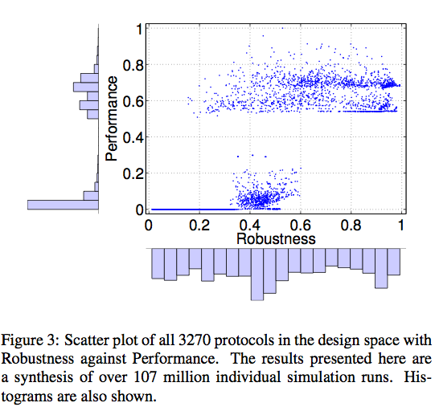

Slide 37
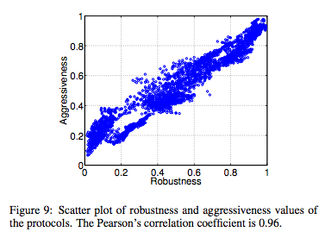

Slide 38
Broad Summary
Lower cluster (low P) all free rider variants who do not reciprocate with partners
Upper cluster (high P) do reciprocate with partners but some defect with strangers
Top P, low number of partners (1,2), Sort Loyal, When Needed
Top R, high number of partners (6-9), Sort Fastest, When Needed, Prop. Share
Sweet spot (P,R>0.8): Sort Loyal

Slide 39
Interesting link to some economic work?
Compare empirical / modelling work: Kirman AP and Vriend NJ (2000) "Learning to be loyal: A study of the Marseille fish market" In: Gatti DD, Gallegati G and Kirman AP, Interaction and market structure: essays on heterogeneity in economics, Volume 484. Springer,

Slide 40
From swarms to collectives
Where we start to see things that look a bit like “real economics” emerge

Slide 41
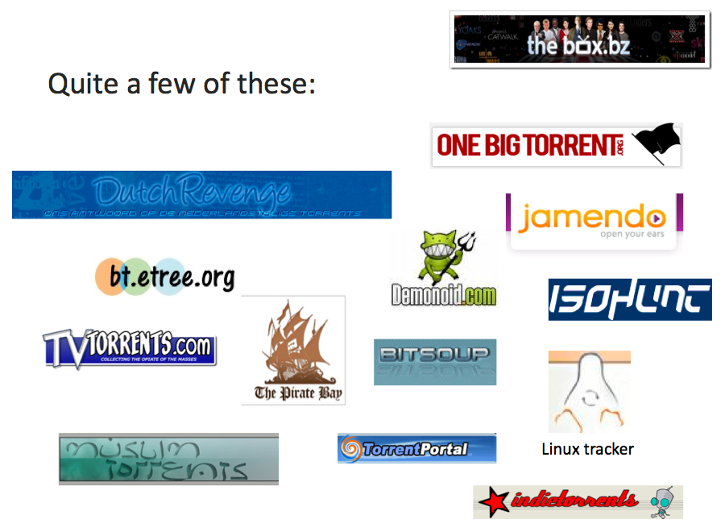
Communities have formed around BitTorrent Trackers

Slide 42
Public Trackers (e.g. PirateBay)
BitTorrent uses Trackers to index swarms
Public trackers let anyone join or create a swarm
Sharing within a swarm is incentivised via a form of tit-for-tat (as we have seen)
However there is no incentive for:
Seeding (uploading after file is downloaded)
Capping (creating and injecting a new file)
Maintaining a Tracker in the first instance

Slide 43
Private Trackers (Many)
Private Trackers have emerged more recently
Only allow registered users to join swarms
May track upload / download of each user
Some keep centralised accounts for each user
When users download much more than upload they may be kicked out
Many different schemes: ratio, credits, points etc
Some rely on users to just be nice with various “gentleman's club” methods

Slide 44
A little detail on credit systems
We will give a little detail on credit systems in private BT communities
Give a flavour of how economic / collective issues are becoming significant
Present results from a simple (agent-based) model and some measurements of a real private tracker

Slide 45
Private Trackers - Credit
Consider a scheme based on credits
Uploading 1MB earns one credit
Downloading 1MB costs one credit
A user with no credits can’t download
Users must be given some initial credit
In fixed size pop. total credit remains constant
Similar to a fixed supply of money in an economy (loose analogy!)

Slide 46
Private Trackers - Credit
How much credit should be put into the system?
How would it effect the efficiency of the system?
When do credit squeezes occur?
How can they be avoided?
We define a credit squeeze as a situation in which,
due to lack of credit, the efficiency of the system is
significantly reduced.

Slide 47
BitCrunch Model
Highly abstract and simplified model
All nodes have equal upload / download
Equally interested in all swarms on the tracker
Always uploading to one swarm (seeding)
Always downloading from another swarm (leeching)
No modelling of tit-for-tat or free-riding
Always online, fixed population
If run out of credit (broke) must wait until earns some via upload before being allowed to download
Swarms assumed to share upload “perfectly”

Slide 48
BitCrunch Model – baseline runs
Parameters:
500 peers, 100 swarms
Peer upload and download capacity = 1 unit
Each file shared in each swarm = 10 units size
One simulation cycle = each swarm processes one unit of time
Run for 20,000 cycles (x10 runs)
For initial credit per peer of 1, 10 and 100 units

Slide 49
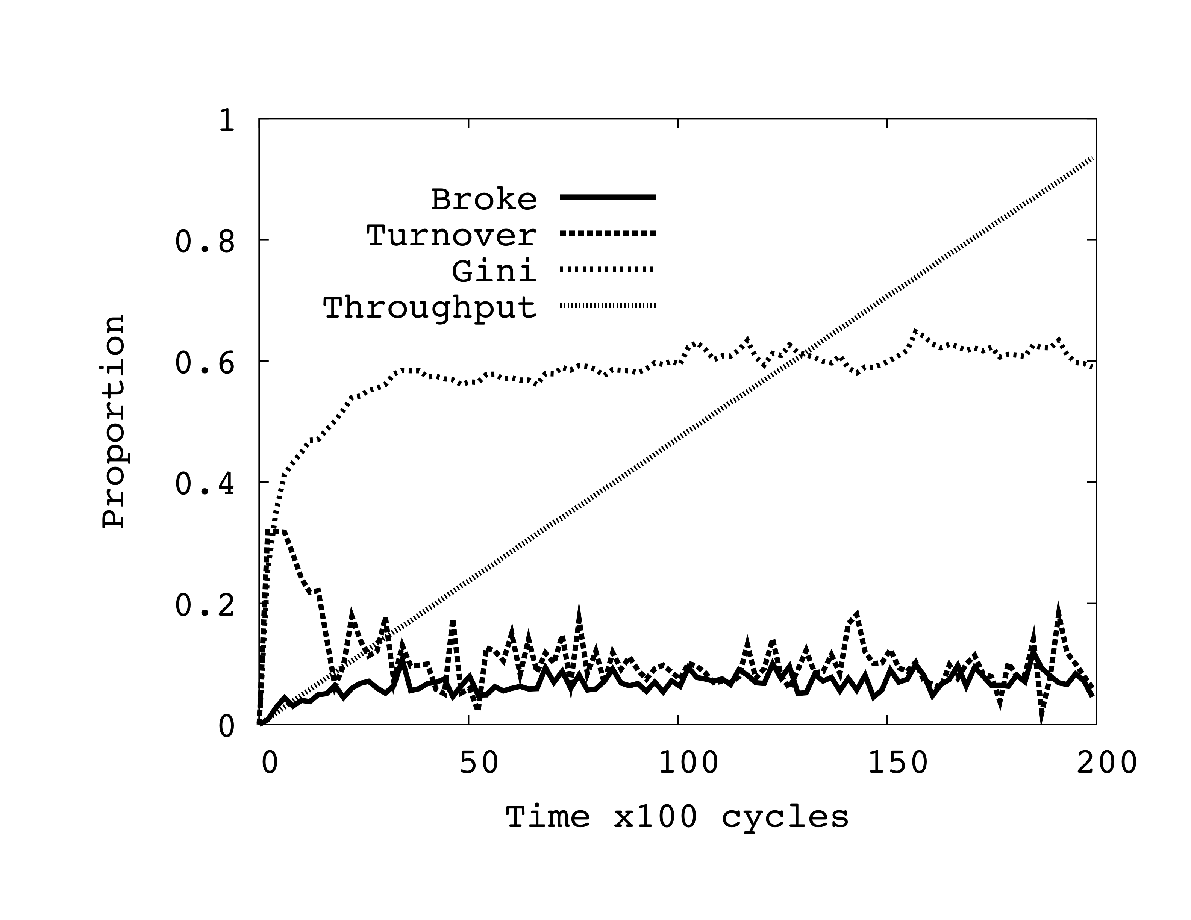
Typical basline simulation run
Initial Credit = 100

Slide 50
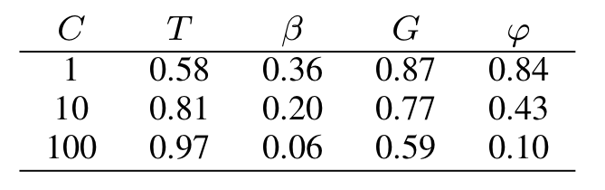
Baseline simulation results
C = initial credit
T = total throughput = total number of units uploaded as proportion of maximum possible (infinite credit)
B = proportion of nodes that are “broke” (zero credit)
G = Gini measure (simple measure of inequality of credit)
Phi = turnover of top 10% of peers ranked by credit (credit mobility)

Slide 51
Unequal capacities runs
To determine what happens when some nodes of different upload capacities
Parameters (same as baseline runs but):
All peers download capacity = 10 units
10% of peers upload capacity = 10 units
90% of peers upload capacity = 1 unit
Examined a (1.5 credit) seeding bonus approach to dynamically introduce more credit into the system

Slide 52
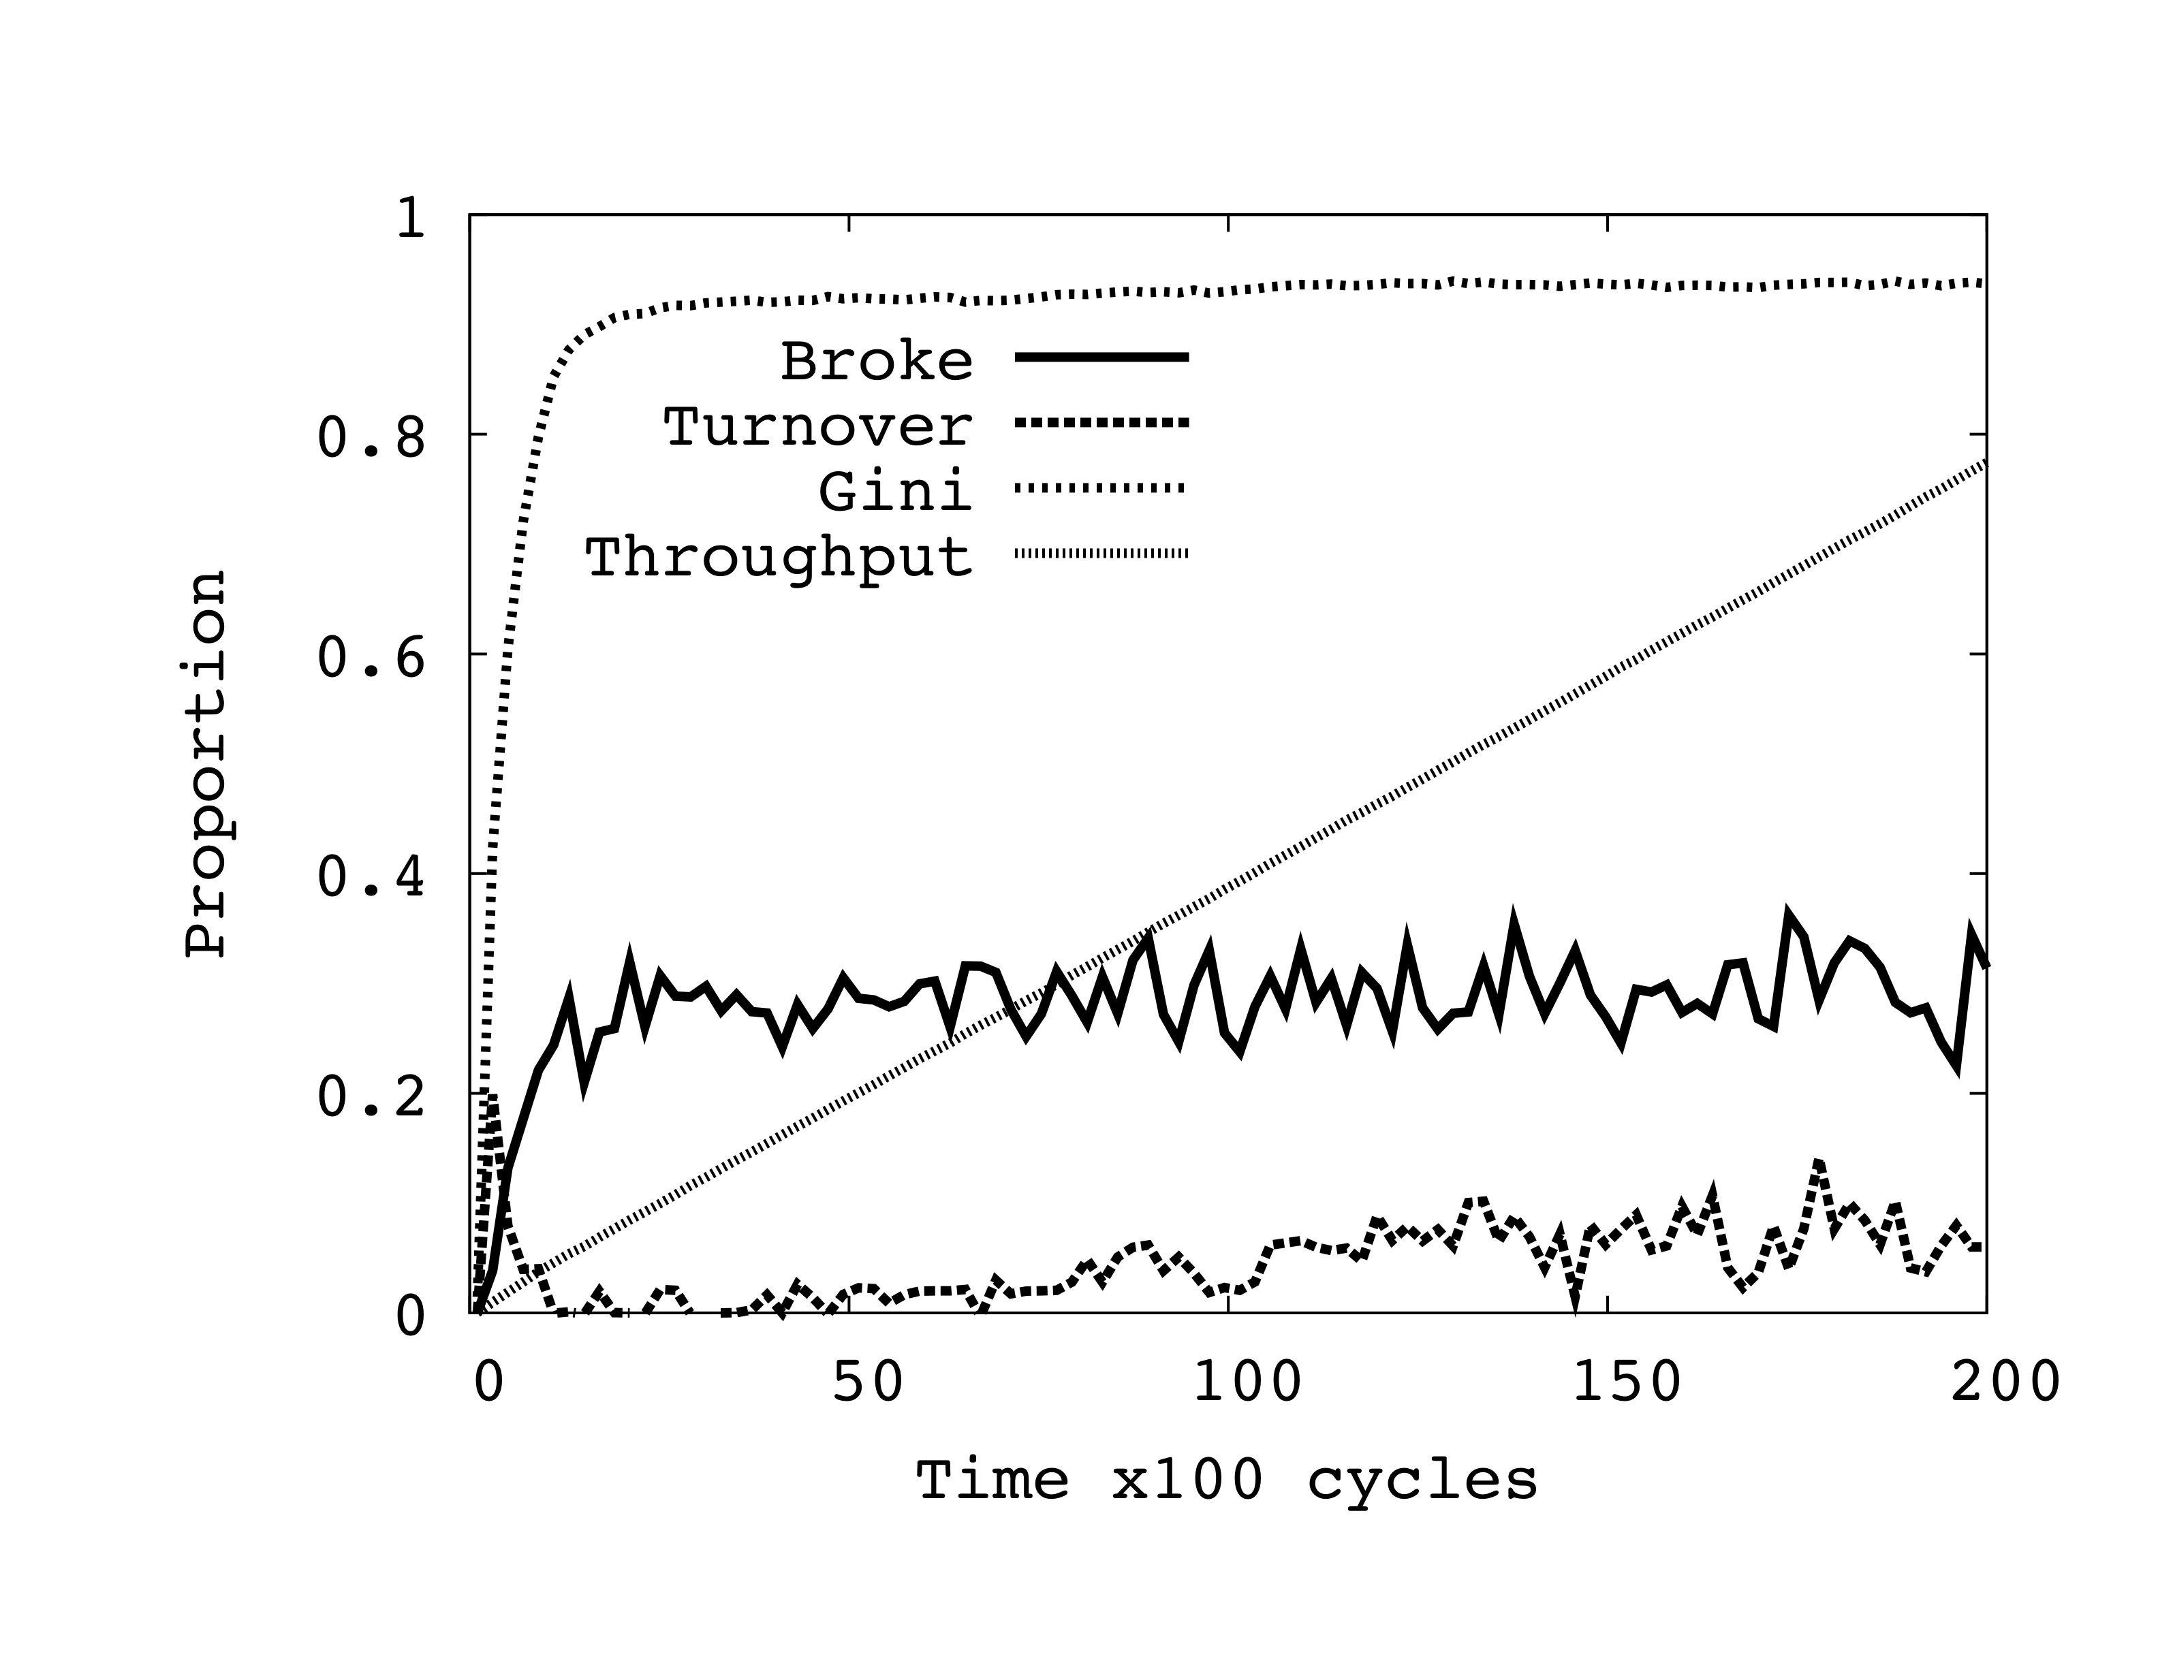
Typical unequal capacities run
Initial Credit = 100

Slide 53
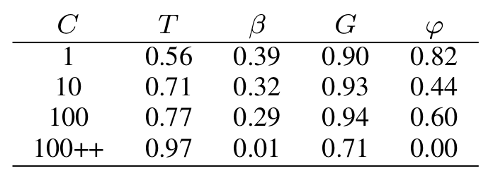
Unequal capacities simulation results
0.06
C = initial credit
T = total throughput = total number of units uploaded as proportion of maximum possible (infinite credit)
B = proportion of nodes that are “broke” (zero credit)
G = Gini measure (simple measure of inequality of credit)
Phi = turnover of top 10% of peers ranked by credit (credit mobility)
100++ indicates initial credit of 100 with 1.5 credit seeding bonus

Slide 54
Observations
Even in a trivial model where all peers have the same capacities and user behaviour, all swarms have equal popularity and all peers start with equal credits, the performance of the system may be inhibited by credit shortages

Slide 55
Observations
Adding extra capacity to the system, in the form of upload and download, can actually reduce the performance. This is highly counter intuitive and something that should be avoided because it implies lack of scalability.

Slide 56
Observations
By injecting new credit into the system in the form of a ``seeding bonus’’ a credit squeeze can be ameliorated when peer capacities are unbalanced.

Slide 57
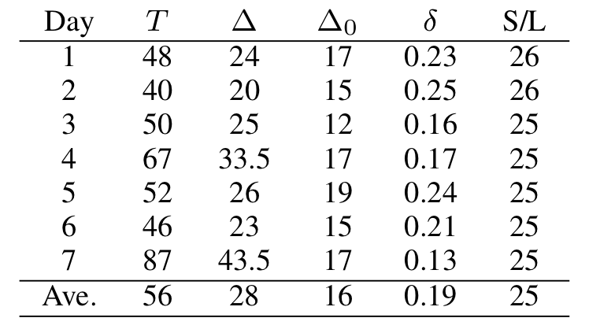
Statistics from a Private Tracker
Approx. 50,000 peers per day, 10,000 swarms,
access to credit balances of top 10%
T = throughput in TB over all swarms
Delta = total credit increase that day in the entire system
Delta0 = total credit increase for top 10% of peers
Delta = minimum fraction of credit increase that goes to top 10% of peers
S/L = seeder to leecher ratio over all swarms

Slide 58
Statistics from a Private Tracker
Indicates “rich getting richer” since top 10% are getting a lot of the new credit
High Seeder / Leecher ratio suggestive that a credit squeeze is happening for many
But need more information to verify this
Would be interesting to see what happened to throughput if there was a “free day” or seeding bonus was increased

Slide 59
Conclusions
Private trackers using “ratio enforcement” policies appear to be ad-hoc and various
But can have dramatic effects on efficiency
Too much credit could encourage free-riding
Too little creates squeezes = lower efficiency
These are just initial investigations
Much more work needs to be done!

Slide 60
Take home message
Communities formed around trackers provide an on-going global socio-economic experiment
Self-organisation of socio-economic structures in measurable forms
Ideas, models and theories from socio-economics may inform and learn from this
Such communities so strong don’t be surprised if they start influencing the “real world” (e.g. the PirateParty)

Slide 61
References
Rahman, R. and Hales, D., Vinko, T., Pouwelse, J. and Sips, H. (2010). No more crash or crunch: sustainable credit dynamics in a P2P community. International Conference on High Performance Computing & Simulation (HPCS 2010)
Rahman, R., Meulpolder, M., Hales, D., Pouwelse, J. and Sips, H. (2010) Improving Efficiency and Fairness in P2P Systems with Effort-Based Incentives. Proceedings of the IEEE International Conference on Communications
Hales, D., Rahman, R., Zhang, B., Meulpolder M., and Pouwelse, J. (2009) BitTorrent or BitCrunch: Evidence of a credit squeeze in BitTorrent? Proceedings of the 5th Collaborative Peer-to-Peer Systems (COPS) Workshop

Slide 62
P2P Open Source Currency
Similar to file sharing systems (like BitTorrent)
Fully decentralized no central trusted authority
Collectively “owned” and “controlled” by users
Cryptography provides security and privacy
Open source code provides transparency
Large design space of monetary policies possible

Slide 63
Example 1: BitCoin (bitcoin.org)
Analogous to “gold” – policy:
There are a maximum number of bitcoins that can exist 21 million (8 decimal places granularity)
Produced through “mining” CPU intensive search increases over time
All transactions broadcast to all nodes
If majority of CPU power in network runs protocol cheating is hard
Mining and potential transaction fees incentivise “good behavior”
Several exchanges, few traders accept, market CAP = $44m

Slide 65
Example 2: Ripple (Ripplepay.com)
Analogous to “bank credit” – policy:
Anyone in the system can issue credit
But only to trusted friends (social network)
Several units of account (incl. bitcoin)
Security and incentives based on existing trust
Early stage no full P2P implementation
No traders or exchanges

Slide 66
Problems…
No single policy or software implementation will work for all people, time and places
But given a sufficient ecology of competing systems…
New systems can emerge, hacked or less useful systems will dissolve
Hacked systems introduce a new kind of Gresham's law
Competition between systems can drive cooperation within them: group selection

Slide 67
Problems…
Each P2P currency is an island (rather like a nation) in which value is trapped
Requires trusted 3rd parties to provide exchanges to allow for movement of value
Fully distributed P2P exchanges?
Some attempt:
https://github.com/macourtney/Dark-Exchange

Slide 68
Solutions?
Assuming open source P2P:
Healthy ecology of completing currencies
Liquid exchanges
Could we borrow an idea from the Chinese central bank?
A composite currency based on a basket of popular P2P currencies
Using open source algorithm to constantly rebalance basket to maintain value

Slide 69
Agent-based models?
Group selection models may be adapted where:
Group = agents holding currency
Cooperation = behaviour that maintains value of currency
Defection = behaviour that inflates or deflates value (including hacking)
Under assumption that agents are boundedly rational copiers of others

Slide 70
A “sparkling” economy
Even an ecology of constantly forming and bursting bubbles “a sparkling economy”
Might produce stable value given a sufficiently “cleaver” algorithm
But no algorithm can know the future for sure
Could we evolve them in simulation?
A task for NESS?

Slide 71
Questions?
Some References:
[1] John F. Nash, “Ideal Money”, Southern Economic Journal, 2002, 69(1). http://www.jstor.org/pss/1061553
[2] H. G. Wells, “The New World Order”, 1940. http://gutenberg.net.au/ebooks04/0400671h.html
[3] People's Bank of China, "Reform the Int. Monetary System", March 2009. http://is.gd/0OhCmS
[4] F. A. Hayek, “The Denationalisation of Money: The Argument Refined”, 1990. http://mises.org/books/denationalisation.pdf
[5] The Economist, Jun 13th 2011. http://www.economist.com/blogs/babbage/2011/06/virtual-currency
[6] Victor Grishchenko, “Bitcoin?”, May 12th 2011. http://www.pds.ewi.tudelft.nl/~victor/bitcoin.html
[7] Gresham’s Law - http://en.wikipedia.org/wiki/Gresham's_law

Slide 72
New Group Selection Models

Slide 73
Group Selection Models
Recent models of “group selection”
Based on individual selection
Producing dynamic social structures
Limit free-riding
Increasingly group-level performance
Don’t require reciprocity
Could be very useful in P2P

Slide 74
Evolutionary Group Selection Models
Group boundary - a mechanism which restricts interactions between agents such that the population is partitioned into groups
Group formation - a process which forms groups dynamically in the population
Migration - a process by which agents may move between different groups
Conditions - cost / benefit ratio of individual interactions and other conditions which are sufficient for producing group-level selection

Slide 75
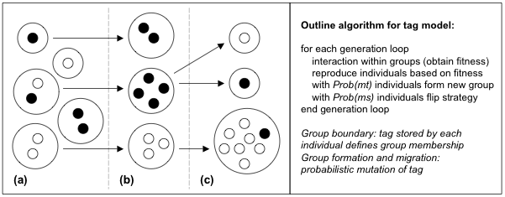
Schematic of the evolution of groups in the tag model. Three generations (a-c) are shown. White individuals are pro-social (altruistic), black are selfish. Individuals sharing the same tag are shown clustered and bounded by large circles. Arrows indicate group linage. When b is the benefit a pro-social agent can confer on another and c is the cost to that agent then the condition for group selection of pro-social groups is: b > c and mt >> ms
Riolo, Axelrod, Cohen, Holland, Hales, Edmonds…

Slide 76
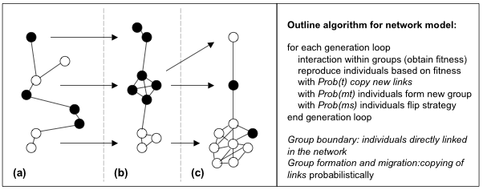
Schematic of the evolution of groups in the network-rewire model. Three generations (a-c) are shown. Altruism selected when:b > c and mt >> ms. When t = 1, get disconnected components, when 1 > t > 0.5, get small-world networks
Hales, D. & Arteconi, S. (2006) Article: SLACER: A Self-Organizing Protocol for Coordination in P2P Networks. IEEE Intelligent Systems, 21(2):29-35
Santos F. C., Pacheco J. M., Lenaerts T. (2006) Cooperation prevails when individuals adjust their social ties. PLoS Comput Biol 2(10)

Slide 77
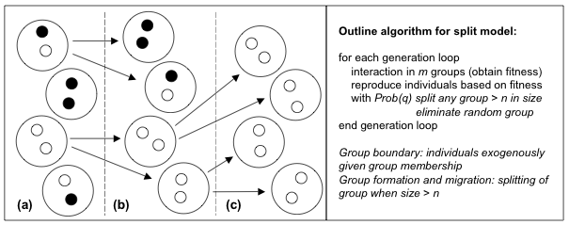
Schematic of the evolution of in the group-splitting model. Three generations (a-c) are shown. Altruism is selected if the population is partitioned into m groups of maximum size n and b / c > 1 + n / m.
Traulsen, A. & Nowak, M. A. (2006). Evolution of cooperation by multilevel selection. Proceedings of the National Academy of Sciences 130(29):10952-10955.

Slide 78
SLAC: Network re-wire P2P model
Agents = nodes in a P2P overlay network
Each node links to some neighbors (view) in overlay
Assume:
Interaction between neighbors to achive some application task
Behavior: Application behavior (i.e. share files or leech files, cooperate or defect)
Utility: Evaluated at application level (i.e. number of files downloaded, performace metric)

Slide 79
SLAC algorithm
Each node p periodically executes the following:
q = SelectRandomPeer()
if utilityq > utilityp
drop all current links
link to node q and copy its strategy and links
mutate (with low probability) strategy and links
fi

Slide 80
SLAC: “Copy and Rewire”
E
F
D
G
C
A
H
B
K
J

Slide 81
SLAC: “Copy and Rewire”
E
F
D
G
C
Compare utilities
A
H
B
K
J

Slide 82
SLAC: “Copy and Rewire”
E
F
D
G
C
A
A
H
“Copy” strategy
B
K
J

Slide 83
SLAC: “Copy and Rewire”
E
F
D
G
C
A
A
H
Drop current links
B
K
J

Slide 84
SLAC: “Copy and Rewire”
E
F
D
G
C
A
A
H
“Rewire”
B
K
J

Slide 85
SLAC: “Mutate”
E
F
D
G
C
A
H
B
K
J

Slide 86
SLAC: “Mutate”
E
F
D
G
C
A
A
H
“Mutate” strategy
B
K
J

Slide 87
SLAC: “Mutate”
E
F
D
G
C
A
A
H
Drop current links
B
K
J

Slide 88
SLAC: “Mutate”
E
F
D
G
C
A
A
H
Link to random node
B
K
J

Slide 89
SLAC playing the PD
We tested SLAC with Prisoner’s Dilemma (PD)
Captures the conflict between “individual rationality” and “common good”
Defection (D) leads to higher individual utility
Cooperation (C) leads to higher global utility
DC > CC > DD > CD
Prisoner’s Dilemma in SLAC
Nodes play PD with neighbors chosen randomly in the interaction network
Only pure strategies (always C or always D)
Strategy mutation: flip current strategy
Utility: average payoff achieved

Slide 90
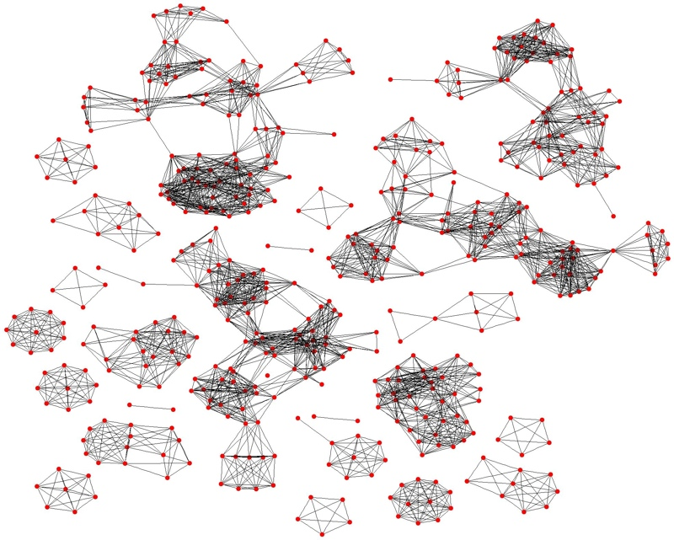
Cycle 180: Small Defect Clusters

Slide 91
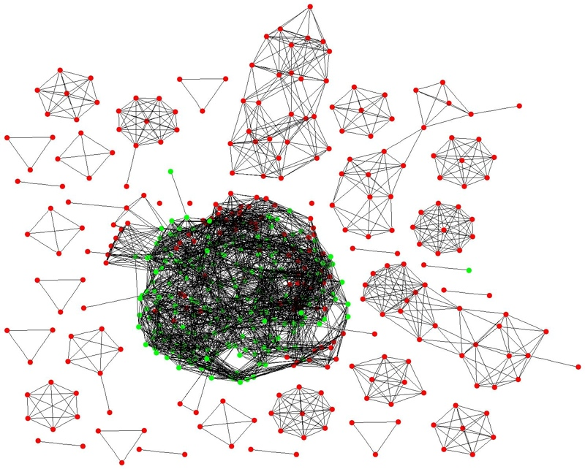
Cycle 220: Cooperation Emerges

Slide 92
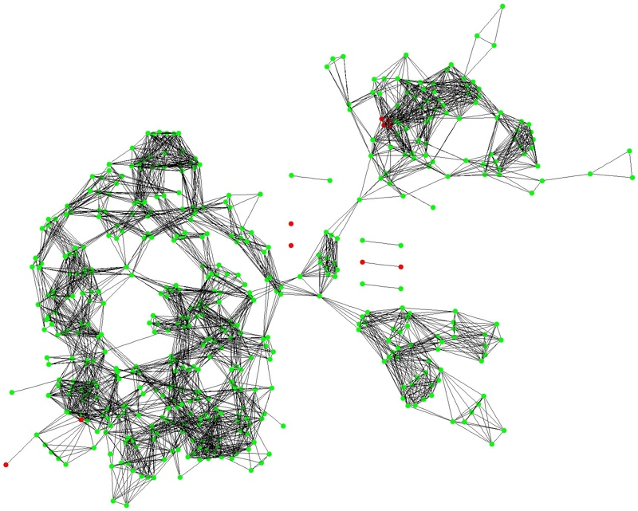
Cycle 230: Coop. Cluster Starts to Break Apart

Slide 93
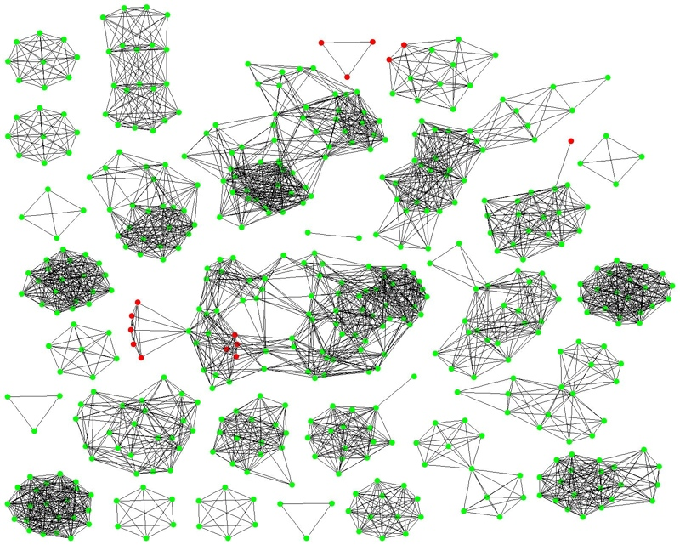
Cycle 300: Defect Nodes Isolated, Small Cooperative Clusters Formed

Slide 94
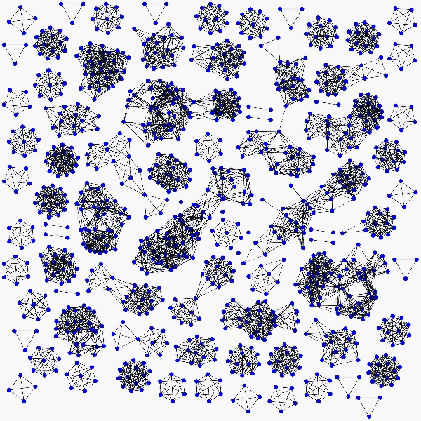

Slide 95
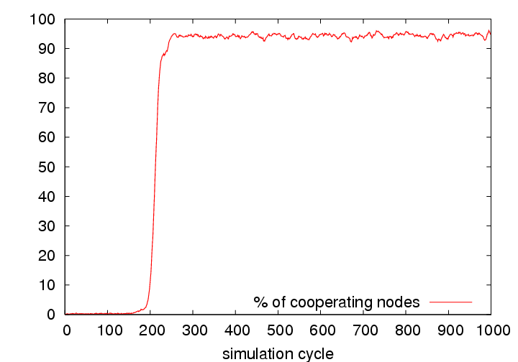
Cooperation Trend

Slide 96
SLAC Summary
SLAC produces very high levels of cooperation limits the spread of defection
Nodes “move” throughout the network to find better neighborhoods
Group-like selection between clusters
Clusters of cooperating nodes grow and persist
Defecting nodes tend to become isolated

Slide 97
SLAC and SLACER
SLAC rewiring mechanism lead to high level of network partitioning
SLACER: When isolating nodes not all the links are drop. Each link is dropped with given probability W
Parameter W represents a tradeoff between network randomness and cooperation level
W=1: high cooperation, high partitioning
W=0.9: high cooperation, small world like topology
Low W: low cooperation, random like topology

Slide 98
SLAC and SLACER
W=1
W=0.9
W=0.3
SLAC
SLACER
As W is increased (probability of dropping a link when moving) then the network becomes more random and cooperation reduces. Intermeidate points give small-world fully connected networks

Slide 99
SLAC and SLACER
We applied variants of SLAC and SLACER in P2P applications:
File-sharing
Content replication for webservers
Job sharing requiring specialisation in the clusters in addition to cooperation

Slide 100
Elinor Ostrom 1990
Ostrom identifies eight "design principles" of stable local common pool resource management:
Clearly defined boundaries (effective exclusion of external unentitled parties);
Rules regarding the appropriation and provision of common resources are adapted to local conditions;
Collective-choice arrangements allow most resource appropriators to participate in the decision-making process;
Effective monitoring by monitors who are part of or accountable to the appropriators;
There is a scale of graduated sanctions for resource appropriators who violate community rules;
Mechanisms of conflict resolution are cheap and of easy access;
The self-determination of the community is recognized by higher-level authorities;
In the case of larger common-pool resources: organization in the form of multiple layers of nested enterprises, with small local CPRs at the base level.

Slide 101
User Models
We need realistic models of how users behave when embedded within given ICT systems
A priori theoretical models tend not work – users rarely behave “rationally” in the sense of maximising some simple utility
Empirical measurements suggest its complex – heterogeneous, adaptive, but progress can be made
Need large-scale deployments / measurements – an empirical / experimental approach

Slide 102
Rawls’ "veil of ignorance" approach
assume we wish to specify the kind of society that is just and good
but we stand outside the society and don't know what role we ourselves would play
we are ignorant of what endowments, knowledge, capacities and position we would hold
what rules / norms would we accept as just and fair? i.e. what would we accept as “collective good”

Slide 103
Designing for common good
We wish to specify the requirements of a system that will structure interaction between peers
the protocol could run on diverse devices with diverse goals, capacities and user behaviour
but we need 1 billion users of the system to make it a success (and get rich)
What collective goals will we define such that many different devices and users would accept and run it?
“do no evil”? or “make the world a better place”? or “from each according to his abilities to each according to his need”?

