Slide 1
Incentives in Transformation – P2P, ABM and (a new kind of) Policy
David Hales, University of Szeged, www.davidhales.com
University of Essex, Wed 26th Feb 2014

Slide 2
Overview of day
09:30 – 11:00 Lecture 1
  ABM, P2P, Evolution of Cooperation
  Tags paper / model
11:30 – 13:00 Lab 1
14:00 – 15:30 Lecture 2
  Papers in P2P
  Tags model again
16:00 – 17:00 Lab 2

Slide 3
Who am I?
Computer scientist (scientist?)
Finished PhD in Artificial Societies (ABM) in Comp. Sci. Dept. Here (Essex) 2001.
Interested in self-org software, cooperation, ALife, MAS, ABM (to understand MAS), then P2P, models of P2P, “complex systems” – apps. file sharing, crypo. currency.
Perpetual postdoc – Essex, Manchester, Bologna, Delft, Milton Keynes, Szeged.

Slide 4
Agent-Based Modelling
You already know what ABM is right?
A set of agents (goals, rules, programs?)
Some shared environment
Agents interact producing some outcome
Hard to predict outcomes
So run program(s) and see what happens
How does this relate to “agency” in economics and social science more generally?

Slide 5
Peer-to-Peer systems (P2P)
What are P2P systems?
Refers to the “architecture” of systems
  Social architecture “person-to-person” (such as P2P lending like zopa.com) [1st wave]
  Infrastructure architecture “node-to-node” (such as P2P file-sharing protocol bittorrent) [2nd wave]
Going to focus on 2nd wave systems – these might be viewed as self-organising software
Interestingly 2nd wave system (I claim) raise interesting policy / legal issues.

Slide 6
P2P systems
Traditional systems have centralised aspects for:
  Legal / commercial reasons (control / administration / business model)
  Technical / efficiency reasons (security / ease of implementation)
P2P (2nd wave) systems have decentralised aspects for:
  Simplicity of set-up (no initial admin or infrastructure outlay required)
  Resilience / efficiency (avoid attacks on central entities / eliminate bottlenecks)

Slide 7
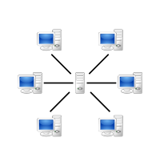
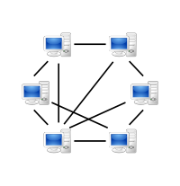
Architecture
Traditional Client / Server
Peer-to-Peer
From: http://en.wikipedia.org/wiki/Peer-to-peer

Slide 8
Architecture matters!
Since P2P systems have no central servers
  No central ownership or control
  No traditional business model
  Often open source projects
This has policy implications (discuss later)
Also has implementation implications
  How to ensure peers do the right thing?
  Distributed incentives, cooperation theory
  i.e. peers must be programmed using some form of socio-economic theory

Slide 9
Architecture - aside
In fact there is no such thing as a fully centralised or fully decentralised system
It’s more of a spectrum
The social and technical aspects interact
There is often a tension between central / decentalised
Historically, things appear to follow a cycle

Slide 10
P2P Terminology
Software running on user devices are called Clients
The way the software behaves and communicates is called the Protocol
The dynamic connections clients make between each other forms what is termed an Overlay Network
Clients communicate by passing messages over the overlay network

Slide 11
Bittorrent example
We are going to take a brief look at the bittorent filesharing protocol
Bittorent probably has more active users than youtube and facebook combined
Uses a major part of all internet bandwidth
Works by incentivising clients to cooperatively upload files they download from each other
But first - cooperation theory
Items in red italics on the following pages can be looked-up on Wikipedia for good background

Slide 12
Individualism v. Collectivism
In socio-economic systems individual interests may conflict with collective interests:
  e.g. over exploitation of a common resource (a river, a field, the atmosphere etc.)
  e.g. banks - lending (to those who they know can not repay) to gain a commission by selling on the debt to other banks
  e.g. P2P file sharing system - downloading more than uploading

Slide 13
Individualism v. Collectivism
Consider a P2P file sharing system:
  It is in the collective interest for all to upload to others so everyone gets the file quickly
  But it is in the individual interest to save bandwidth by only downloading and hence free-riding on others
  Free-riding (or free-loading) is a perennial problem in P2P file-sharing systems
  Any efficient system needs to tackle it in some way

Slide 14
The tragedy of the commons
These kinds of situations have been termed “commons dilemmas” or “common pool resource dilemmas”
Called “dilemmas” because we would all be better off if we “did the right thing” but there is an individual incentive to do the wrong thing
G. Hardin (1968) summarized the issue in his famous paper: “The Tragedy of the Commons”
These kinds of situations occur in P2P file-sharing systems like BitTorrent

Slide 15
Avoiding a commons tragedy?
Central enforcement of correct behaviour
  require centralised agencies and policing
  ability to identify and track individuals centrally
  not suitable for pure P2P (but used with private trackers)
Decentralised methods
  self-policing producing incentives for cooperation
  do not require centralised coordination
  more suitable for pure P2P
  can apply ideas from “game theory”

Slide 16
What is game theory?
A way to mathematically analyse games assuming we know:
  number of players
  possible moves they can make (strategies)
  outcome of game based on players moves (pay-off)
  desirability of game outcomes for each player (utility)

Slide 17
What game are you playing?
Games can be categorised into two types:
Zero-sum games
  when one player wins another loses
  summing the final utilities of players = 0
  e.g. poker, chess, monopoly etc.
2) Non-zero-sum games
  utilities do not always sum to zero
  both players may lose or both may win
  considered to capture social / economic realities
  e.g. tragedy of the commons examples

Slide 18
Capturing a commons tragedy with a simple game
Consider a game composed of two players:
  each player:
    has choice of one move (C or D)
    makes a single move then the game ends
    does not know how the other will move
    gets a payoff (or utility) based on how they moved and how the other player moved
  for certain payoff values this game can, minimally, capture a form of commons tragedy (or dilemma)
  a classic such game is called the Prisoner’s Dilemma

Slide 19
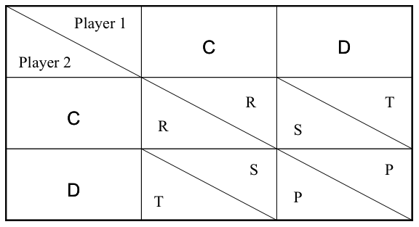
The Prisoner’s Dilemma -
“payoff matrix”
Game is a PD when: T > R > P > S and 2R > T + S
(3)
(5)
(3)
(0)
(0)
(1)
(5)
(1)

Slide 20
The Prisoner's Dilemma - example games
Players => |  | P1 | P2 |  | P1 | P2 |  | P1 | P2 |  | P1 | P2
Moves => |  | C | C |  | C | D |  | D | C |  | D | D
Payoffs => |  | R | R |  | S | T |  | T | S |  | P | P
Values => |  | 3 | 3 |  | 0 | 5 |  | 5 | 0 |  | 1 | 1
Total => |  | 6 |  |  | 5 |  |  | 5 |  |  | 2
A contradiction between collective and individual interests

Slide 21
Game theory says defect!
Game theory assumes players are:
  rational - attempt to maximise their utility
  selfish - don’t care about the other guy
  knowledgeable - have complete information
  clever - have unlimited computational time
Given these assumptions it can be proved:
  agents will select equilibria where no player will improve by changing strategy unilaterally
  many games have such equilibria - by the famous John Nash (so-called Nash Equilibrium - NE)
  the NE for the PD is DD (all defect)

Slide 22
Iterated Prisoner’s Dilemma
Previous example “one-shot” PD but:
  real world interactions often repeated
  might meet the guy you just ripped-off in the future
  allows for more complex sequence of strategies based on past interactions with others
  can punish someone tomorrow for defecting against you today - “the shadow of the future”
Iterated PD (IPD) captures this and, as we will see, maps well onto P2P file-sharing protocols like BitTorrent

Slide 23
What is the rational thing to do in the IPD?
Traditional game theory has trouble here:
  cooperative equilibria exist in infinitely repeated games but not in finite games of known length
  many equilibria exist and it is not clear which one would be chosen by rational agents
  In all cases defection on every round is still a equilibrium even when cooperative equilibria exist
For these reasons Robert Axelrod (political scientist), in the late 70’s, decided to find out what kinds of strategies worked well in the IPD by using computer simulation

Slide 24
Axelrod’s Tournament - programs as strategies
Axelrod organised an open IPD tournament:
  Academics were asked to submit programs (BASIC or FORTRAN) that would play the IPD against each other
  Nobody knew competitors code
  The only input would be the on-going past history of the game (a string of C’s and D’s)
  The aim was to get the highest score (utility) based on round-robin playoffs between all pairs of programs
  Axelrod’s aim was to see which programs did best against all the others and understand why
  He wrote-up his results in the famous book “the evolution of cooperation”

Slide 25
Axlerod’s Tournament - what happened?
Basic results were:
  many strategies were submitted (complex and simple)
  the one with the highest overall score turned out to be simple: tit-for-tat (TFT) or “look back”
  starts playing C, then “looked back” at the last move made by opponent and copied that move
  submitted by Psychologist Anatol Rapoport
  didn’t “win” against each strategy but did better overall on average against all strategies
  TFT mechanism an example of “reciprocal altruism” (Robert Trivers)

Slide 26
What has this got to do with BitTorrent?
In the BitTorrent protocol:
  TFT-like method used for sharing files
  nodes form groups interested in a particular file (swarms) and swap or “barter” pieces with each other
  if a node does not upload data then this can be compared to defection
  it is punished in the future by being “choked” - not getting upload from others
  even if you hack your client to be selfish the chances are the standard TFT-like protocol will do better overall
  Bram Cohen - original BT designer - inspired by Axelrod’s tournaments (I believe)

Slide 27
Some BitTorrent Terminology
Swarm: set of peers interested in a file
  file is split in smaller chunks called pieces
  seeder: holds a full copy of the data
  leecher: holds only a part of the data (initially nothing)
Tracker: centralized (!) manager
  keep track of all peers in the swarm
  return list of current peers in swarm
Torrent file: meta-data
  contains pointer to tracker hosting the swarm
  details about the file - hash, no. of pieces, size etc.

Slide 28
BitTorrent Protocol
Get a list of other peers in the swarm from the tracker
Ask peers their list of pieces and tell them what is yours
Exchange pieces with appropriate peers

Slide 29
The Global Ecology of BitTorrent Clients
Many bittorrent clients exist in “the wild”
  Bittorrent 6 (from Bittorrent.com, formally utorrent)
  Others: Azureus, ABC, Transmission, many others…
  bad guy clients: BitThief, BitTyrant
Hence:
  The current bittorrent ecosystem is a global on-going experiment, like Axelrod’s, but with huge user base and rich interactions (not just TFT) incredible strategy sophistication
  This is unprecedented and will surely lead to new economic theory – (perhaps in general!)

Slide 30
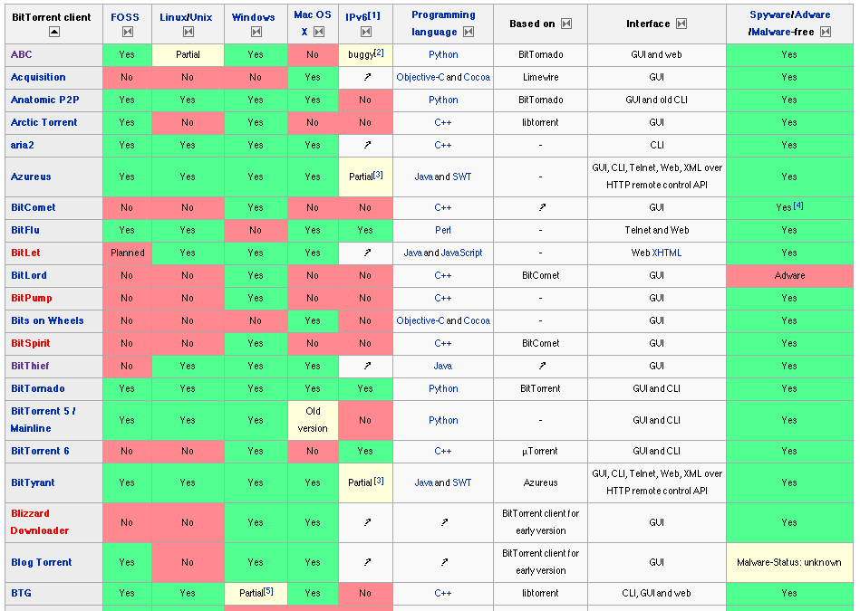
BitTorrent Clients

Slide 31
Take home message
Previous work in social / economic science (Axelrod’s IPD) has provided a basis for protocol design in a P2P system
Deployed variants of the protocol are creating a massive global economic experiment
Measurements can be made and these could inform new theory and new protocols

Slide 32
References
Nash, John (1950) Equilibrium points in n-person games. Proceedings of the National Academy of Sciences 36(1):48-49.
John von Neumann and Oskar Morgenstern: Theory of Games and Economic Behavior, Princeton University Press (1944)
Robert Axelrod (1984) The Evolution of Cooperation, Basic Books
Nowak, M.A. and Sigmund, K. (1998) Evolution of indirect reciprocity by image scoring, Nature 393, 573.
Garrett Hardin (1968) The Tragedy of the Commons Science 162, 1243-1248.
Trivers, R.L. (1971). The evolution of reciprocal altruism. Quarterly Review of Biology. 46: 35-57
Maynard Smith, J. (1982) Evolution and the Theory of Games. Cambridge University Press

Slide 33
From swarms to collectives
Where we start to see things that look a bit like “real economics” emerge

Slide 34
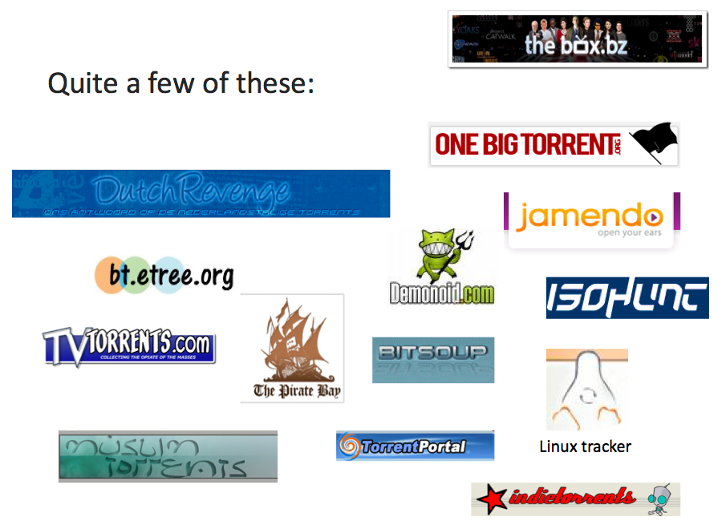
Communities have formed around BitTorrent Trackers

Slide 35
Public Trackers (e.g. PirateBay)
BitTorrent uses Trackers to index swarms
Public trackers let anyone join or create a swarm
Sharing within a swarm is incentivised via a form of tit-for-tat (as we have seen)
However there is no incentive for:
  Seeding (uploading after file is downloaded)
  Capping (creating and injecting a new file)
  Maintaining a Tracker in the first instance

Slide 36
Private Trackers (Many)
Private Trackers have emerged more recently
Only allow registered users to join swarms
May track upload / download of each user
Some keep centralised accounts for each user
  When users download much more than upload they may be kicked out
  Many different schemes: ratio, credits, points etc
Some rely on users to just be nice with various “gentleman's club” methods

Slide 37
A little detail on credit systems
We will give a little detail on credit systems in private BT communities
Give a flavour of how economic / collective issues are becoming significant
Present results from a simple (agent-based) model and some measurements of a real private tracker

Slide 38
Private Trackers - Credit
Consider a scheme based on credits
  Uploading 1MB earns one credit
  Downloading 1MB costs one credit
  A user with no credits can’t download
Users must be given some initial credit
In fixed size pop. total credit remains constant
Similar to a fixed supply of money in an economy (loose analogy!)

Slide 39
Private Trackers - Credit
How much credit should be put into the system?
How would it effect the efficiency of the system?
When do credit squeezes occur?
How can they be avoided?
We define a credit squeeze as a situation in which,
due to lack of credit, the efficiency of the system is
significantly reduced.

Slide 40
BitCrunch Model
Highly abstract and simplified model
  All nodes have equal upload / download
  Equally interested in all swarms on the tracker
  Always uploading to one swarm (seeding)
  Always downloading from another swarm (leeching)
  No modelling of tit-for-tat or free-riding
  Always online, fixed population
  If run out of credit (broke) must wait until earns some via upload before being allowed to download
  Swarms assumed to share upload “perfectly”

Slide 41
BitCrunch Model – baseline runs
Parameters:
  500 peers, 100 swarms
  Peer upload and download capacity = 1 unit
  Each file shared in each swarm = 10 units size
  One simulation cycle = each swarm processes one unit of time
  Run for 20,000 cycles (x10 runs)
  For initial credit per peer of 1, 10 and 100 units

Slide 42
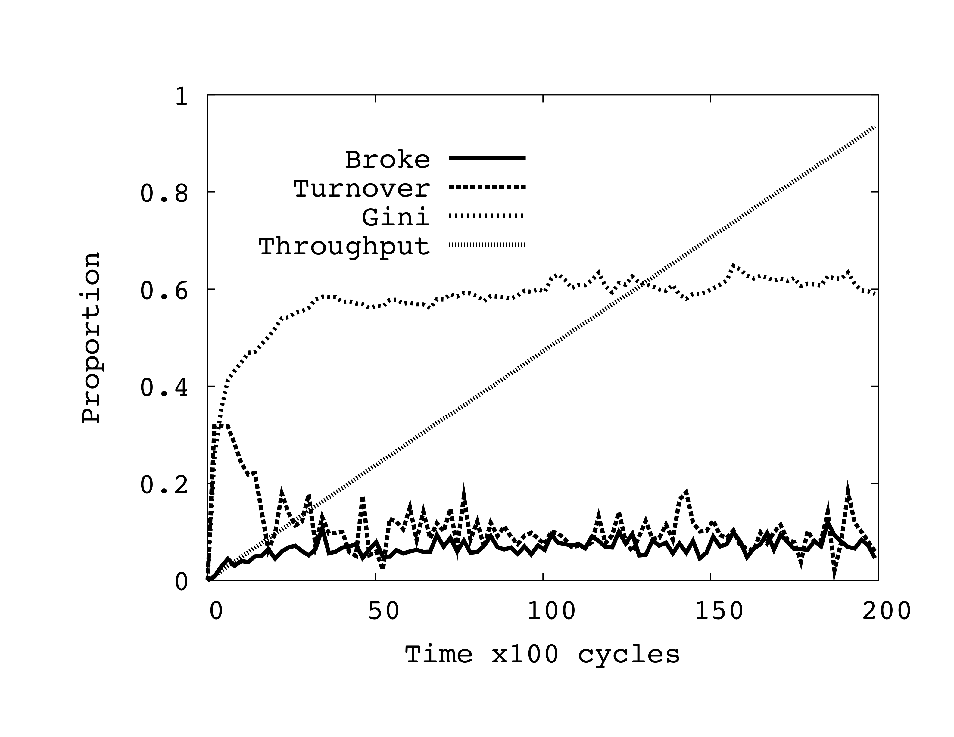
Typical basline simulation run
Initial Credit = 100

Slide 43
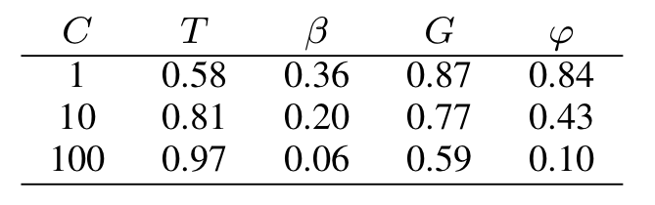
Baseline simulation results
C = initial credit
T = total throughput = total number of units uploaded as proportion of maximum possible (infinite credit)
B = proportion of nodes that are “broke” (zero credit)
G = Gini measure (simple measure of inequality of credit)
Phi = turnover of top 10% of peers ranked by credit (credit mobility)

Slide 44
Unequal capacities runs
To determine what happens when some nodes of different upload capacities
Parameters (same as baseline runs but):
  All peers download capacity = 10 units
  10% of peers upload capacity = 10 units
  90% of peers upload capacity = 1 unit
  Examined a (1.5 credit) seeding bonus approach to dynamically introduce more credit into the system

Slide 45
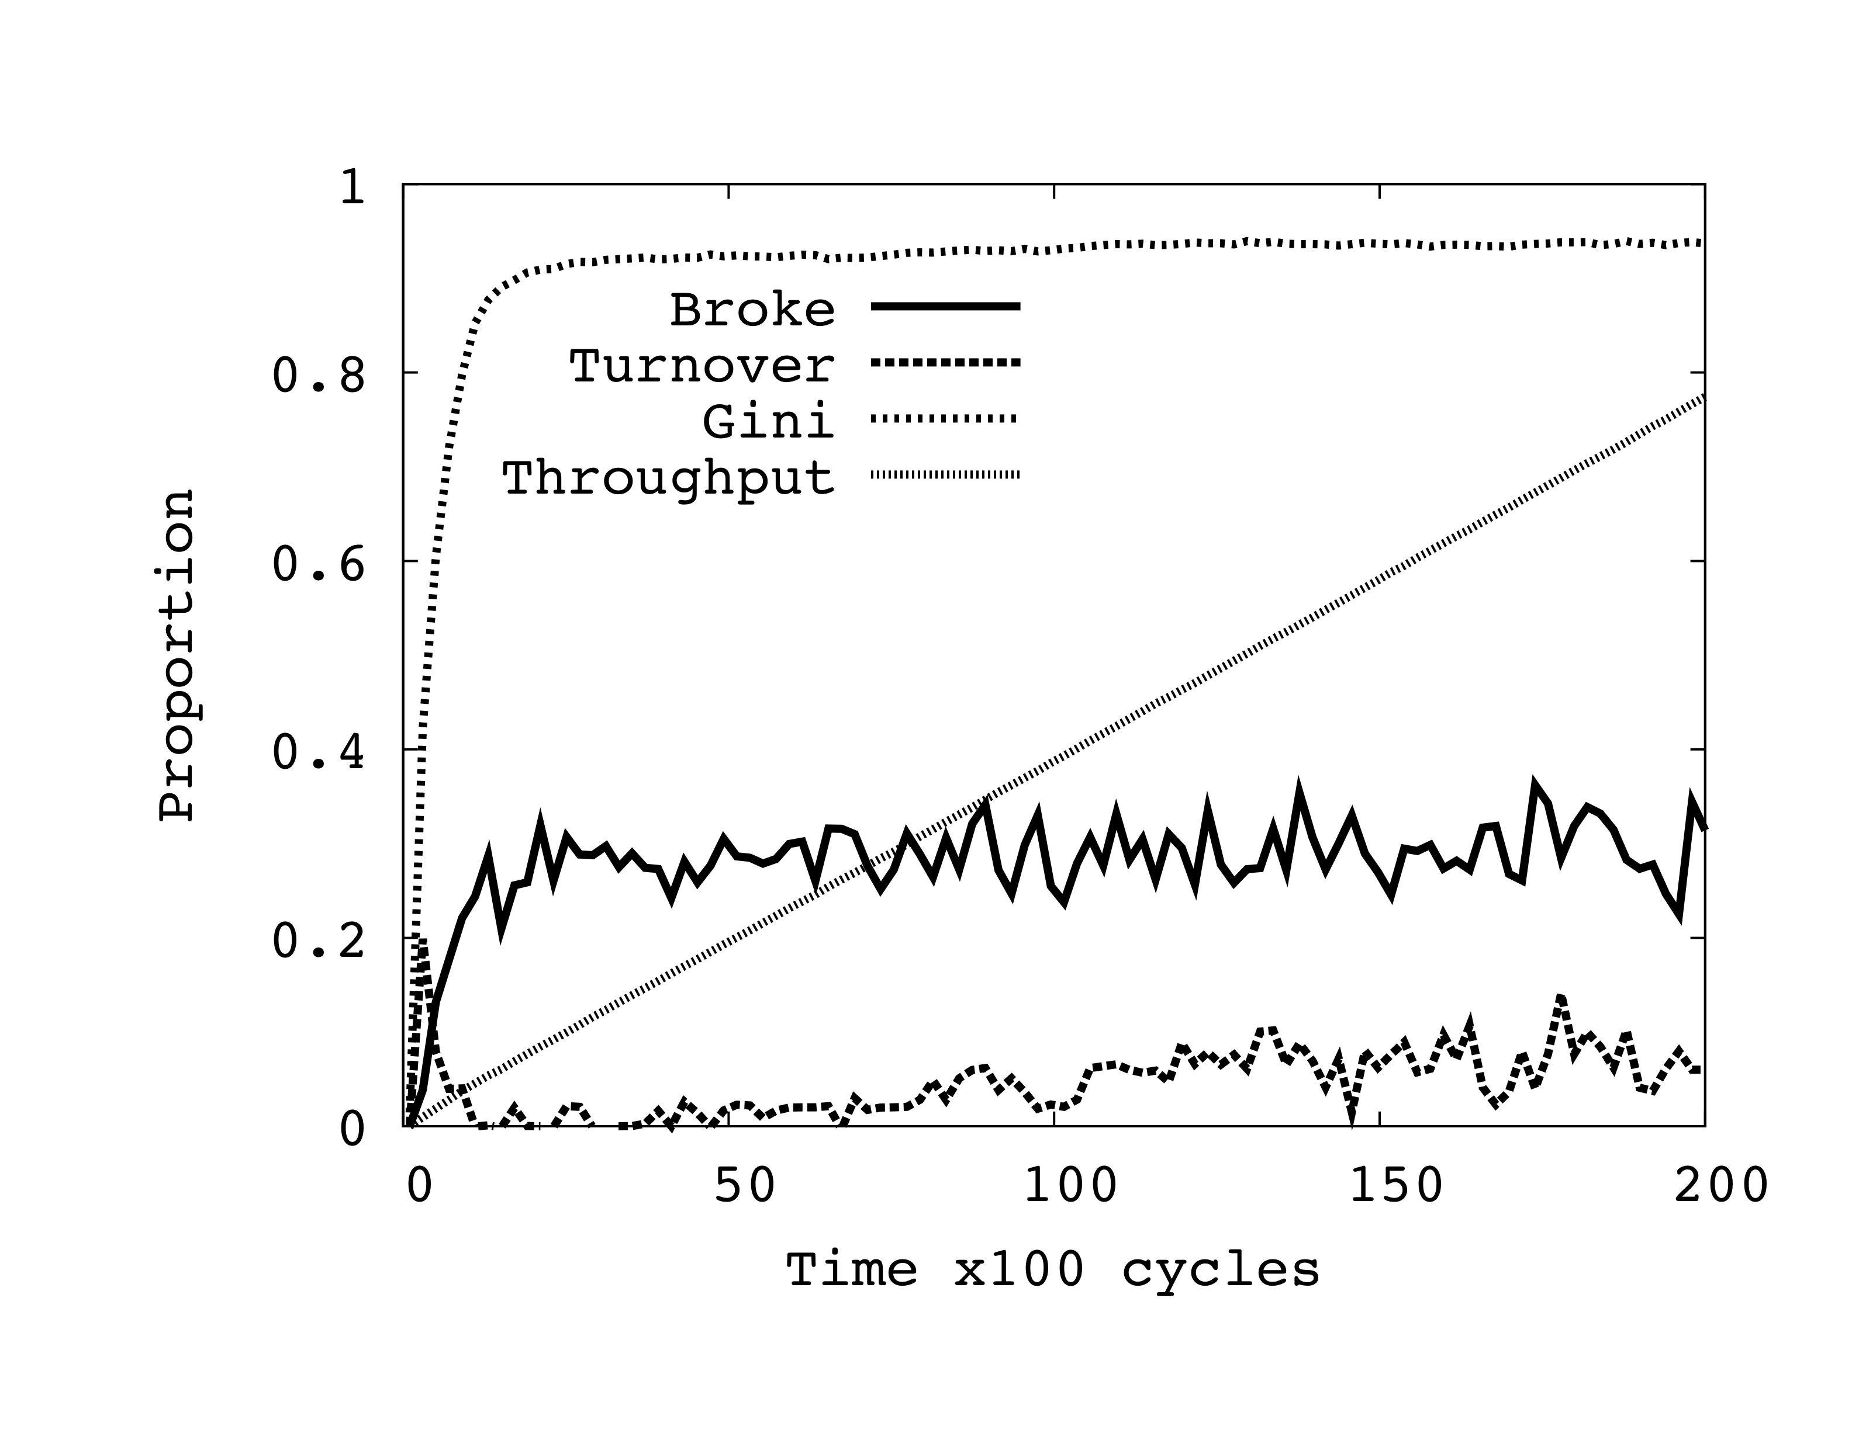
Typical unequal capacities run
Initial Credit = 100

Slide 46
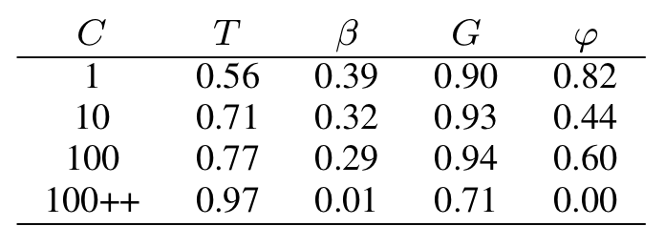
Unequal capacities simulation results
0.06
C = initial credit
T = total throughput = total number of units uploaded as proportion of maximum possible (infinite credit)
B = proportion of nodes that are “broke” (zero credit)
G = Gini measure (simple measure of inequality of credit)
Phi = turnover of top 10% of peers ranked by credit (credit mobility)
100++ indicates initial credit of 100 with 1.5 credit seeding bonus

Slide 47
Observations
Even in a trivial model where all peers have the same capacities and user behaviour, all swarms have equal popularity and all peers start with equal credits, the performance of the system may be inhibited by credit shortages

Slide 48
Observations
Adding extra capacity to the system, in the form of upload and download, can actually reduce the performance. This is highly counter intuitive and something that should be avoided because it implies lack of scalability.

Slide 49
Observations
By injecting new credit into the system in the form of a ``seeding bonus’’ a credit squeeze can be ameliorated when peer capacities are unbalanced.

Slide 50
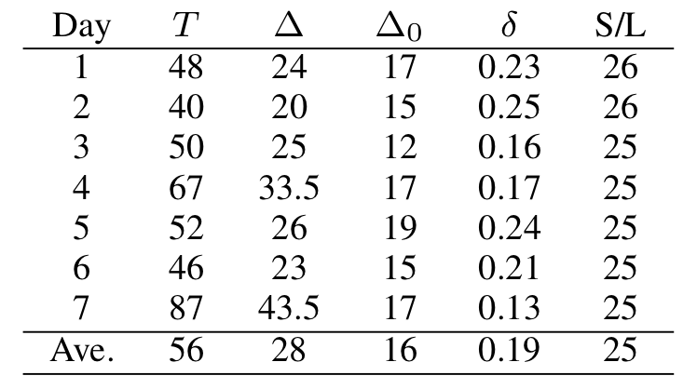
Statistics from a Private Tracker
Approx. 50,000 peers per day, 10,000 swarms,
access to credit balances of top 10%
T = throughput in TB over all swarms
Delta = total credit increase that day in the entire system
Delta0 = total credit increase for top 10% of peers
Delta = minimum fraction of credit increase that goes to top 10% of peers
S/L = seeder to leecher ratio over all swarms

Slide 51
Statistics from a Private Tracker
Indicates “rich getting richer” since top 10% are getting a lot of the new credit
High Seeder / Leecher ratio suggestive that a credit squeeze is happening for many
But need more information to verify this
Would be interesting to see what happened to throughput if there was a “free day” or seeding bonus was increased

Slide 52
Conclusions
Private trackers using “ratio enforcement” policies appear to be ad-hoc and various
But can have dramatic effects on efficiency
Too much credit could encourage free-riding
Too little creates squeezes = lower efficiency
These are just initial investigations
Much more work needs to be done!

Slide 53
Take home message
Communities formed around trackers provide an on-going global socio-economic experiment
Self-organisation of socio-economic structures in measurable forms
Ideas, models and theories from socio-economics may inform and learn from this
Such communities so strong don’t be surprised if they start influencing the “real world” (e.g. the PirateParty)

Slide 54
References
Rahman, R. and Hales, D., Vinko, T., Pouwelse, J. and Sips, H. (2010). No more crash or crunch: sustainable credit dynamics in a P2P community. International Conference on High Performance Computing & Simulation (HPCS 2010)
Rahman, R., Meulpolder, M., Hales, D., Pouwelse, J. and Sips, H. (2010) Improving Efficiency and Fairness in P2P Systems with Effort-Based Incentives. Proceedings of the IEEE International Conference on Communications
Hales, D., Rahman, R., Zhang, B., Meulpolder M., and Pouwelse, J. (2009) BitTorrent or BitCrunch: Evidence of a credit squeeze in BitTorrent? Proceedings of the 5th Collaborative Peer-to-Peer Systems (COPS) Workshop

Slide 55
What are we trying to do?
Where we ask “what is a socially intelligent ICT system?”

Slide 56
COSI-ICT (ASSYST)
Complex Systems Science for Socially Intelligent ICT
Cluster of four IPS:
Qlectives, Epiwork, Socionical, Cybermotions
ASSYST is an associated CA - action for the science of complex systems and socially intelligent ICT
http://www.assystcomplexity.eu/

Slide 57
Basic Questions from Jeff Johnson
What is ICT-enabled social intelligence?
What theories exists on social intelligence?
Are there engineering principles for creating social intelligence systems?

Slide 58
1. What is ICT enabled social intelligence?
First let’s ask:
What is Social Intelligence?

Slide 59
What is social intelligence?
Answer
It is the opposite of:
Antisocial stupidity

Slide 60
What is social intelligence?
What is meant by intelligence?
  doing the right thing to achieve goals given the information at hand (reason)
  learning from experience in order to improve performance (adaptation / learning)
What is meant by social?
  some population of intelligent entities (agents)
  agents cooperate to achieve their goals
  goals of agents may or may not conflict
  interactions restricted by spatial, temporal and informational constraints - may be dynamic

Slide 61
What is social intelligence
Feedback mechanisms:
  individual (micro) to collective (macro)
  collective (macro) to individual (micro)
Leading to, emergent, “collectively good” outcomes
  Adam Smith called it the “hidden hand” in the context of markets
  Many mechanisms other than markets

Slide 62
1. What is ICT enabled social intelligence?
Social intelligence in which:
  ICT plays a significant role in social mediation
  The agents are users and possibly computational agents and services
  enables the emergence of “collectively good” outcomes through e.g.:
    Fostering cooperation (incentives)
    Conflict resolution (norms, rules, policing)
    “Fair” and “productive” allocation of resources
    Filtering out “bad” adaptations and spreading “good” adaptations

Slide 63
2. What theories exists on social intelligence?
Evolutionary theory: reciprocal altruism, kin, group and cultural group selection
  How +ve social behaviors / strategies / norms emerge through evolutionary processes
Common pool resource theory: Ostrom’s CPRG
  How people govern common resources collectively and productively
Social contract theory: Rawls’ “Theory of Justice”
  Using reason to derive just social norms / laws that others subscribe to rationally
Economics, markets, peer production, symbolic interactionism, enthnomethodology…

Slide 64
3. Engineering principles for creating social intelligence systems?
Active research area we focus on in QLectives
Socially inspired design patterns for P2P:
  Direct reciprocity (e.g. TFT in BitTorrent)
  Indirect reciprocity (e.g. credit / points systems)
  Group selection (e.g. evolving communities)
  Altruistic punishment (e.g. self-policing)
See QLectives deliverable D2.1.1 for details on www.qlectives.eu

Slide 65
Elinor Ostrom 1990
Ostrom identifies eight "design principles" of stable local common pool resource management:
Clearly defined boundaries (effective exclusion of external unentitled parties);
Rules regarding the appropriation and provision of common resources are adapted to local conditions;
Collective-choice arrangements allow most resource appropriators to participate in the decision-making process;
Effective monitoring by monitors who are part of or accountable to the appropriators;
There is a scale of graduated sanctions for resource appropriators who violate community rules;
Mechanisms of conflict resolution are cheap and of easy access;
The self-determination of the community is recognized by higher-level authorities;
In the case of larger common-pool resources: organization in the form of multiple layers of nested enterprises, with small local CPRs at the base level.

Slide 66
User Models
We need realistic models of how users behave when embedded within given ICT systems
A priori theoretical models tend not work – users rarely behave “rationally” in the sense of maximising some simple utility
Empirical measurements suggest its complex – heterogeneous, adaptive, but progress can be made
Need large-scale deployments / measurements – an empirical / experimental approach

Slide 67
Rawls’ "veil of ignorance" approach
assume we wish to specify the kind of society that is just and good
but we stand outside the society and don't know what role we ourselves would play
  we are ignorant of what endowments, knowledge, capacities and position we would hold
what rules / norms would we accept as just and fair? i.e. what would we accept as “collective good”

Slide 68
Designing a socially int. system
We wish to specify the requirements of a system that will structure interaction between peers
the protocol could run on diverse devices with diverse goals, capacities and user behaviour
but we need 1 billion users of the system to make it a success (and get rich)
What collective goals will we define such that many different devices and users would accept and run it?
  “do no evil”? or “make the world a better place”? or “from each according to his abilities to each according to his need”?

Slide 69
Replacing the banks….

Slide 70
Tragedy of the financial commons
Some examples:
  Individual bank creates excessive credit through lax loans that can be securitised and sold on (to another bank)
  Asset bubbles transfer wealth from the majority to the minority
  State debases the coin via printing money
Two broad responses:
  More central control – Hobbsian Leviathan
  Less central control – Efficient markets

Slide 71
Some financial functions
Value transfer
Credit creation
Value storage
Exchange of services and products
Quality money?

Slide 72
Alternative
Possible emerging alternative:
  Radically decentralise systems that support financial functions
  Use emerging trends in distributed information systems
  Alternative economic / cooperation theories

Slide 73
Emerging trends in info. systems
Over recent years a number trends have emerged within information systems:
  social networks (facebook, LinkedIn)
  peer production (wikipedia, open source)
  peer-to-peer systems (BitTorrent)
  virtual currencies (second life, farmville, BitCoin)
  cheap mobile devices connected to global networks

Slide 74
Alternative cooperation theories
Bottom-up forms of altruism and trust
  group selection, migration
Reciprocity:
  direct, indirect, network
Others:
  affinity, reputation, altruistic punishment

Slide 75
Some on-going projects
P2P lending (lend/borrow directly)
Members banks (become a bank)
Money free economies (eliminate money)
P2P money (create your own money)

Slide 76
Eliminating banks / interest
Zopa – P2P lending system without a bank. Nonlocal, becoming successful
JAK Bank – Members bank controlled by and for only the members. Eliminates interest. Highly local

Slide 77
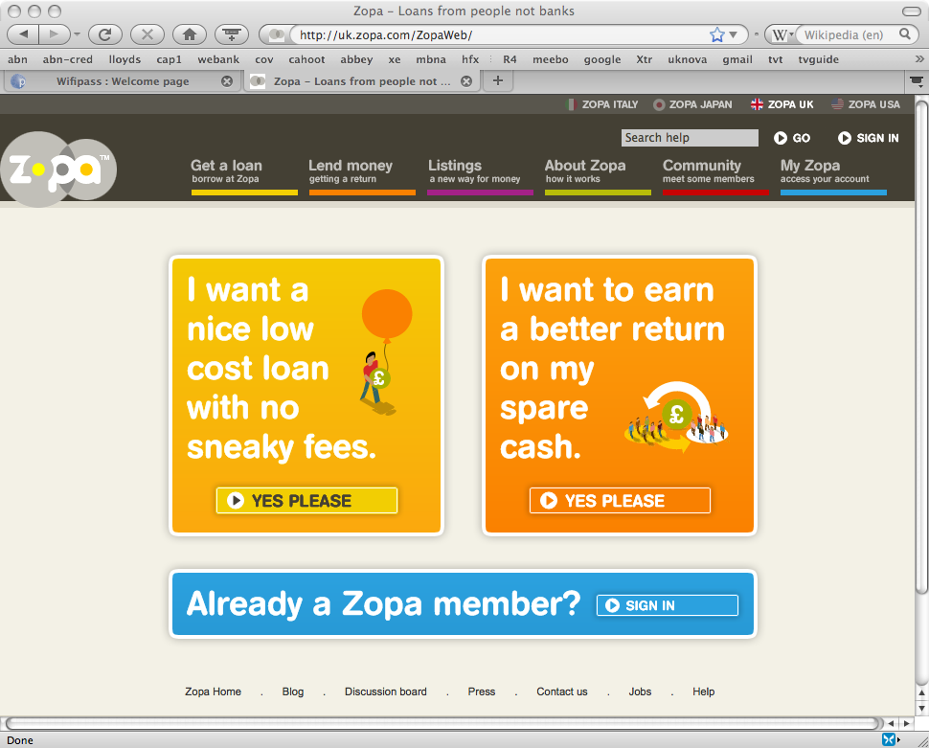

Slide 78


Slide 79
Eliminating money
CouchSurfing – people freely share spare accommodation all over the world. Global and active
Freecomony – people freely share anything (generally localised)

Slide 80
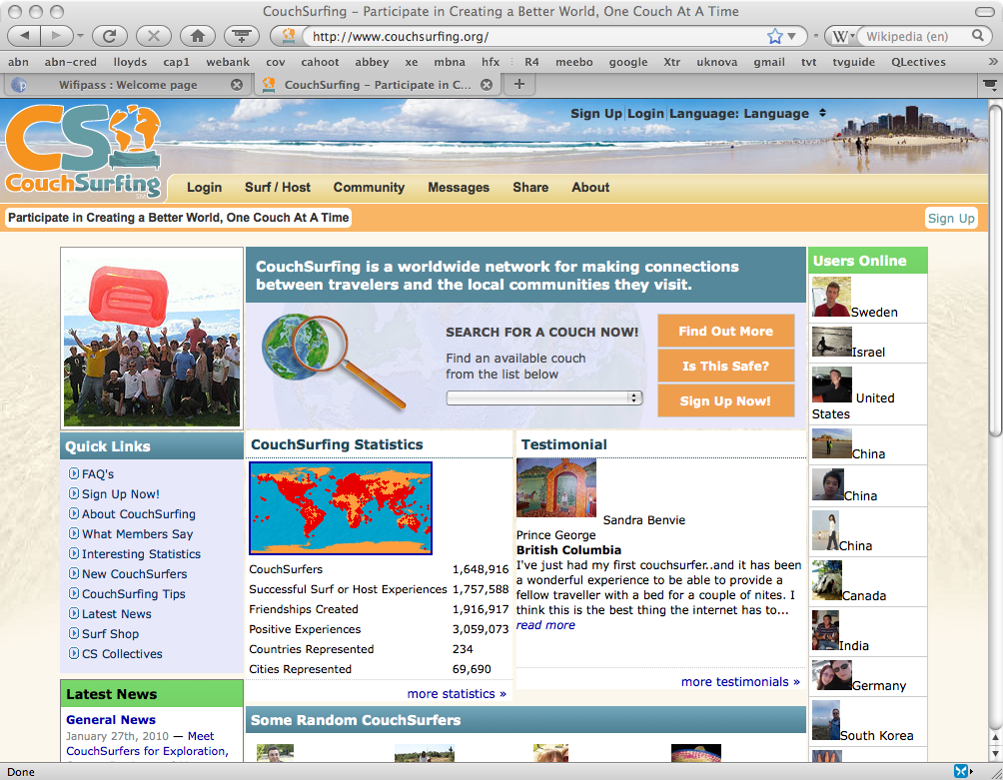

Slide 81
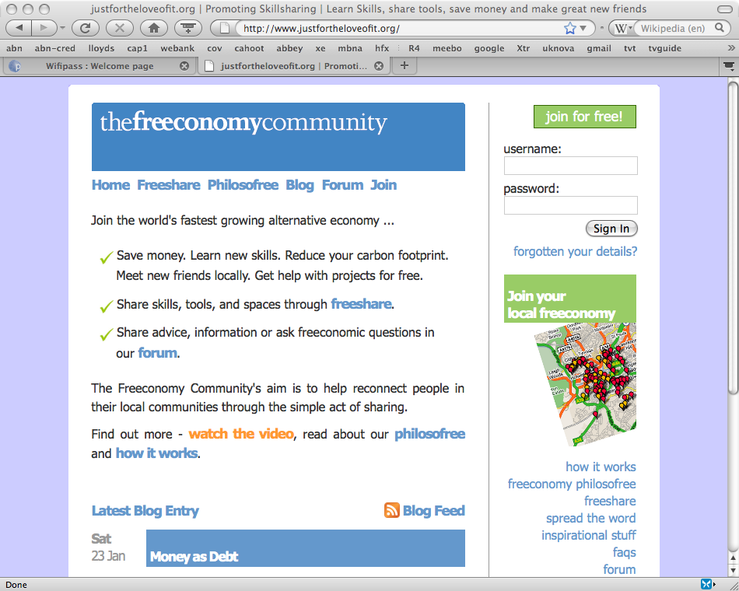

Slide 82
P2P money
Using a social network of trusted friends
Each person can apply a credit level to each link in any monetary unit
Payments between nodes (value transfer) involves the system finding a route of credit between nodes
Depends on trust and enough back-to-back transfers to balance over time
Compare to Hawala system and other “informal value transfer” IVT, systems

Slide 83
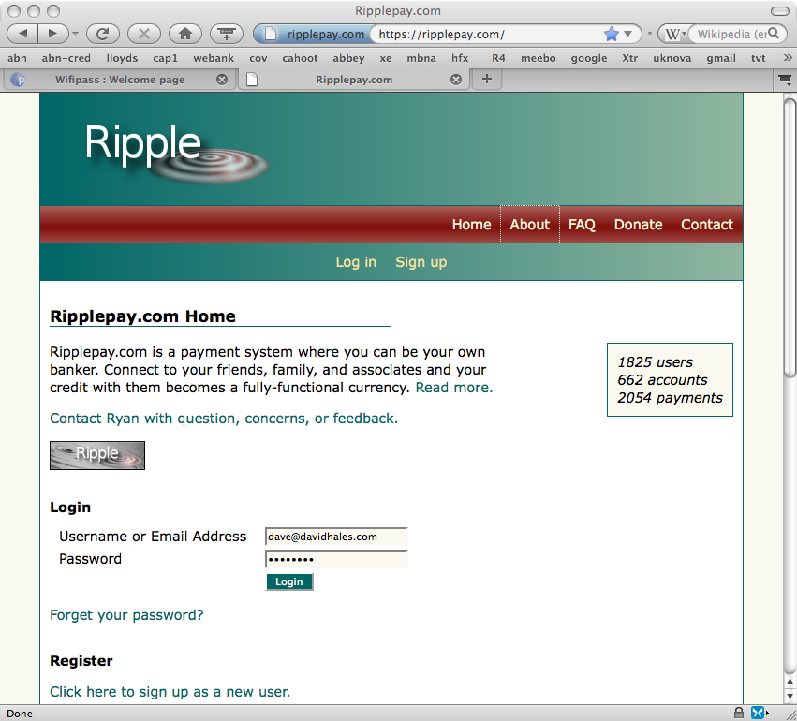

Slide 84
P2P Money
Currently know of no widely used deployed system (but BitCoin gaining ground)
Bootstrapping problem - possible way forward:
  Create a p2p virtual currency in a virtual game world with existing social networks
  Take detailed measurements and collect data
  See if it works and produce models
  If successful grow the currency outside the virtual game

Slide 85
BitCoin
P2P fully distributed crypto-currency
Distributed database of all transaction (transparency)
Various anti-attack mechanisms
No central control = should be hard to shutdown
New coins issued in a controlled and distributed way
Seems to be in a speculative bubble right now

Slide 86
Quality money
Subjective rating = objective quality?
In a given community:
  if enough people believe a unit of exchange is high quality they will accept it for payment
  then it is high quality
  But, you can only fool all of the people some of time…

Slide 87
Let 1000 experiments bloom
Given a sufficient ecology of financial commons systems (avoiding a financial monoculture)
Individuals can “vote with their feet” migrating to those that are of high quality
Hence even “rational” behaviour could drive quality rather than driving it out
Tiebout (1956), Hayek (1978)

Slide 88
Bits and bats
Some leftover slides that might be interesting

Slide 89
Trends
Recent trends
  Peer Production (wikipedia, open source)
  Social Networks (facebook)
  Peer-to-Peer (P2P) systems (bittorrent, skype)
Related themes
  Communities not individuals (social)
  Sharing, giving, social production without traditional economic incentives
  New kinds of “commons” new kinds of tools for managing those commons

