Slide 1
The social transformation and your role in it
David Hales
The Open University
www.davidhales.com

Slide 2
Models of people matter
Models of social phenomena are social theories
Social theories matter because they influence how we interpret things and hence act
So models change, not only reflect, the world
Models influence the design of systems that change things
You are already using social models

Slide 3
Quote:
“The ideas of economists and political philosophers, both when they are right and when they are wrong, are more powerful than is commonly understood. Indeed the world is ruled by little else. Practical men, who believe themselves to be quite exempt from any intellectual influence, are usually the slaves of some defunct economist.”
John Maynard Keynes (English economist, journalist, and financier, 1883-1946)

Slide 4
Quote:
“It is not from the benevolence of the butcher, the brewer, or the baker that we expect our dinner, but from their regard to their own interest. We address ourselves, not to their humanity, but to their self-love, and never talk to them of our own necessities, but of their advantages.”
Adam Smith (Scottish economist and philosopher, 1623-1790)

Slide 5
Quote:
“The philosophers have only interpreted the world, in various ways. The point, however, is to change it.”
“From each according to his abilities, to each according to his needs.”
Karl Heinrich Marx (German political philosopher, political economist, and social theorist, 1818-1883)

Slide 6
Quote:
"during the time men live without a common power to keep them all in awe, they are in that condition which is called war; and such a war as is of every man against every man.”
Thomas Hobbes (English philosopher 1588-1679)

Slide 7
Quote
"I made a mistake in presuming that the self-interests of organisations, specifically banks and others, were such that they were best capable of protecting their own shareholders and their equity in the firms.”
Alan Greenspan (American economist 1926-)

Slide 8
Individualism v. Collectivism
In socio-economic systems individual interests may conflict with collective interests:
  e.g. over exploitation of a common resource (a river, a field, the atmosphere etc.)
  e.g. banks - lending (to those who they know can not repay) to gain a commission by selling on the debt to other banks
  e.g. P2P file sharing system - downloading more than uploading

Slide 9
Individualism v. Collectivism
Consider a P2P file sharing system:
  It is in the collective interest for all to upload to others so everyone gets the file quickly
  But it is in the individual interest to save bandwidth by only downloading and hence free-riding on others
  Free-riding (or free-loading) is a perennial problem in P2P file-sharing systems
  Any efficient system needs to tackle it in some way

Slide 10
The tragedy of the commons
These kinds of situations have been termed “commons dilemmas” or “common pool resource dilemmas”
Called “dilemmas” because we would all be better off if we “did the right thing” but there is an individual incentive to do the wrong thing
G. Hardin (1968) summarized the issue in his famous paper: “The Tragedy of the Commons”

Slide 11
How to avoid the commons tragedy?
Central enforcement of correct behaviour (top down)
  require beneficent centralised agencies and policing
  ability to identify and track individuals centrally
  Who polices the police?
  Absolute authority of the monarch - Hobbs
Decentralised methods (bottom up)
  incentives for cooperation based on individual self-interest
  Complete individual autonomy
  The market – Smith / Nash equilibrium (game theory)

Slide 12
What is game theory?
Way to mathematically analyse games assuming we know:
  number of players
  possible moves they can make (strategies)
  outcome of game based on players moves (pay-off)
  desirability of game outcomes for each player (utility)
  the players are “rational”, “homo-economicus” agents

Slide 13
Game theory comes with a whole set of assumptions
Developed as a response to the problem of the cold war within RAND corporation
Assumes extremely selfish and non-communicating agents
And extremely intelligent and well informed agents – “rational fools”
Nice solution concepts elegant mathematics
Losing credibility in economics (my opinion)

Slide 14
Top down
Requires commitment to central plan decided in advance and imposed
Specification of correct behaviour decided remotely in space and time
Limits autonomy of individuals
Tendency to treat individuals as homogenous applying universal laws
A “social contract” exists

Slide 15
Bottom-up
Assumes agents know what they want
Don’t care what others want
Can determine the best way to get it
no communication
no coordination
no constraints on autonomy
Tendency to treat agents as homogenous
An incentive structure exists

Slide 16
Combining top-down/bottom-up
In the real world often both extremes fail
Hence often find mixtures of the two where top-down imposes the “incentive structure” for bottom-up activity e.g.:
  “carbon trading”
  “target based public services”
But still suffers from top-down problems pushed into “creating the right incentives”

Slide 17
Combining top-down/bottom-up
Another way is through the bottom-up creation of top-down (like) constraints on bottom-up interaction
Self-organised groups create norms, structures and institutions which influence individual behaviour e.g.:
  Stigmergic behaviour in ants (minimal)
  Group selection, self-organised CPRG groups
  Wikipedia, open source?

Slide 18
Stigmergy
“Stigmergy is a mechanism of indirect coordination between agents or actions. The principle is that the trace left in the environment by an action stimulates the performance of a next action, by the same or a different agent. In that way, subsequent actions tend to reinforce and build on each other, leading to the spontaneous emergence of coherent, apparently systematic activity.”
Wikipedia

Slide 19
Stigmergic ant foraging
Consider a colony of ants
They need to find resources and bring them back to the nest
New resources may appear and old ones may disappear
Individual ants may disappear (die)
How to organise efficient logistics under these difficult conditions without central planning?

Slide 20
Stigmergic foraging
Consider each ant follows this simple rule:
  Leave nest and wander around randomly
  If you detect a pheromone trail then follow it
  If you bump into a resource
    Pick it up
    Deposit a pheromone trail behind you
    Go back to nest
The pheromone trail is a signal left in the environment that other ants can follow
Over time it dissipates away leaving no trace

Slide 21
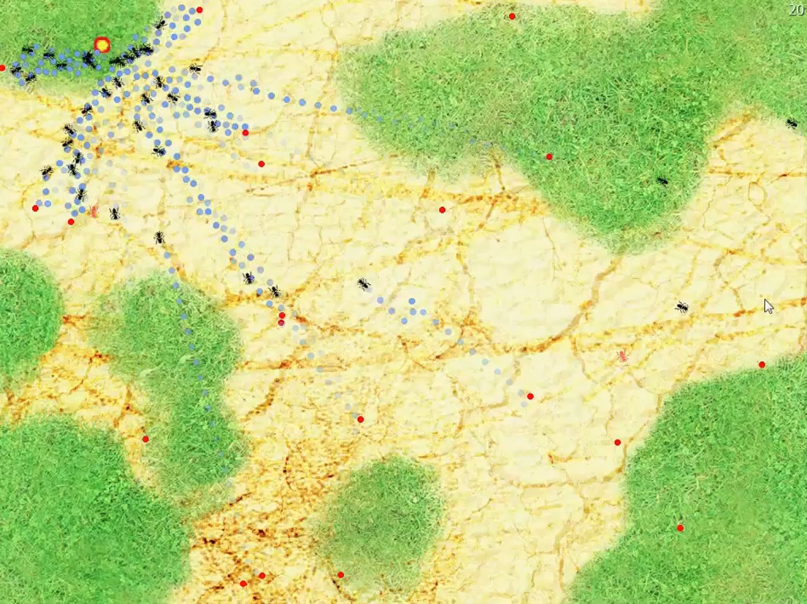
Stigmergic ant foraging

Slide 22
Governing the commons - Elinor Ostrom 1990
Ostrom identifies eight "design principles" of stable local common pool resource management:
Clearly defined boundaries (effective exclusion of external unentitled parties);
Rules regarding the appropriation and provision of common resources are adapted to local conditions;
Collective-choice arrangements allow most resource appropriators to participate in the decision-making process;
Effective monitoring by monitors who are part of or accountable to the appropriators;
There is a scale of graduated sanctions for resource appropriators who violate community rules;
Mechanisms of conflict resolution are cheap and of easy access;
The self-determination of the community is recognized by higher-level authorities;
In the case of larger common-pool resources: organization in the form of multiple layers of nested enterprises, with small local CPRs at the base level.

Slide 23
Group Selection Models
Recent models of “group selection”
Based on individual selection
Producing dynamic social structures
Limit free-riding
Increasingly group-level performance
Don’t require reciprocity
Could be very useful in P2P

Slide 24
Evolutionary Group Selection Models
Group boundary - a mechanism which restricts interactions between agents such that the population is partitioned into groups
Group formation - a process which forms groups dynamically in the population
Migration - a process by which agents may move between different groups
Conditions - cost / benefit ratio of individual interactions and other conditions which are sufficient for producing group-level selection

Slide 25
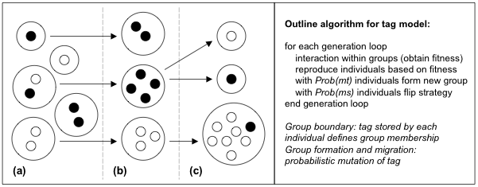
Schematic of the evolution of groups in the tag model. Three generations (a-c) are shown. White individuals are pro-social (altruistic), black are selfish. Individuals sharing the same tag are shown clustered and bounded by large circles. Arrows indicate group linage. When b is the benefit a pro-social agent can confer on another and c is the cost to that agent then the condition for group selection of pro-social groups is: b > c and mt >> ms
Riolo, Axelrod, Cohen, Holland, Hales, Edmonds…

Slide 26
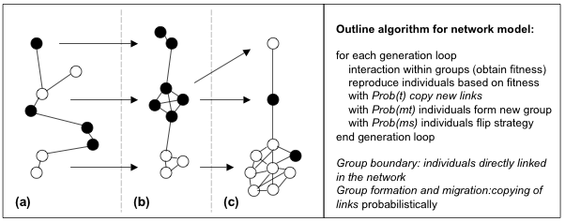
Schematic of the evolution of groups in the network-rewire model. Three generations (a-c) are shown. Altruism selected when:b > c and mt >> ms. When t = 1, get disconnected components, when 1 > t > 0.5, get small-world networks
Hales, D. & Arteconi, S. (2006) Article: SLACER: A Self-Organizing Protocol for Coordination in P2P Networks. IEEE Intelligent Systems, 21(2):29-35
Santos F. C., Pacheco J. M., Lenaerts T. (2006) Cooperation prevails when individuals adjust their social ties. PLoS Comput Biol 2(10)

Slide 27
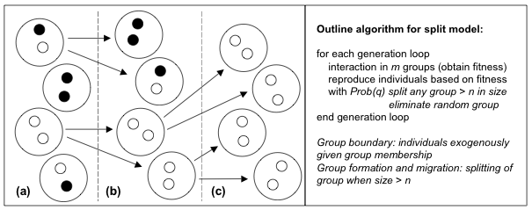
Schematic of the evolution of in the group-splitting model. Three generations (a-c) are shown. Altruism is selected if the population is partitioned into m groups of maximum size n and b / c > 1 + n / m.
Traulsen, A. & Nowak, M. A. (2006). Evolution of cooperation by multilevel selection. Proceedings of the National Academy of Sciences 130(29):10952-10955.

Slide 28
SLAC: Network re-wire P2P model
Agents = nodes in a P2P overlay network
Each node links to some neighbors (view) in overlay
Assume:
  Interaction between neighbors to achive some application task
  Behavior: Application behavior (i.e. share files or leech files, cooperate or defect)
  Utility: Evaluated at application level (i.e. number of files downloaded, performace metric)

Slide 29
SLAC algorithm
Each node p periodically executes the following:
q = SelectRandomPeer()
if utilityq > utilityp
  drop all current links
  link to node q and copy its strategy and links
  mutate (with low probability) strategy and links
fi

Slide 30
SLAC: “Copy and Rewire”
E
F
D
G
C
A
H
B
K
J

Slide 31
SLAC: “Copy and Rewire”
E
F
D
G
C
Compare utilities
A
H
B
K
J

Slide 32
SLAC: “Copy and Rewire”
E
F
D
G
C
A
A
H
“Copy” strategy
B
K
J

Slide 33
SLAC: “Copy and Rewire”
E
F
D
G
C
A
A
H
Drop current links
B
K
J

Slide 34
SLAC: “Copy and Rewire”
E
F
D
G
C
A
A
H
“Rewire”
B
K
J

Slide 35
SLAC: “Mutate”
E
F
D
G
C
A
H
B
K
J

Slide 36
SLAC: “Mutate”
E
F
D
G
C
A
A
H
“Mutate” strategy
B
K
J

Slide 37
SLAC: “Mutate”
E
F
D
G
C
A
A
H
Drop current links
B
K
J

Slide 38
SLAC: “Mutate”
E
F
D
G
C
A
A
H
Link to random node
B
K
J

Slide 39
SLAC playing the PD
We tested SLAC with Prisoner’s Dilemma (PD)
  Captures the conflict between “individual rationality” and “common good”
  Defection (D) leads to higher individual utility
  Cooperation (C) leads to higher global utility
  DC > CC > DD > CD
Prisoner’s Dilemma in SLAC
  Nodes play PD with neighbors chosen randomly in the interaction network
  Only pure strategies (always C or always D)
  Strategy mutation: flip current strategy
  Utility: average payoff achieved

Slide 40
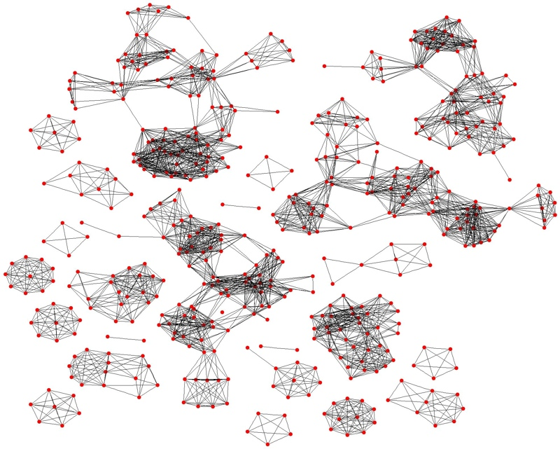
Cycle 180: Small Defect Clusters

Slide 41
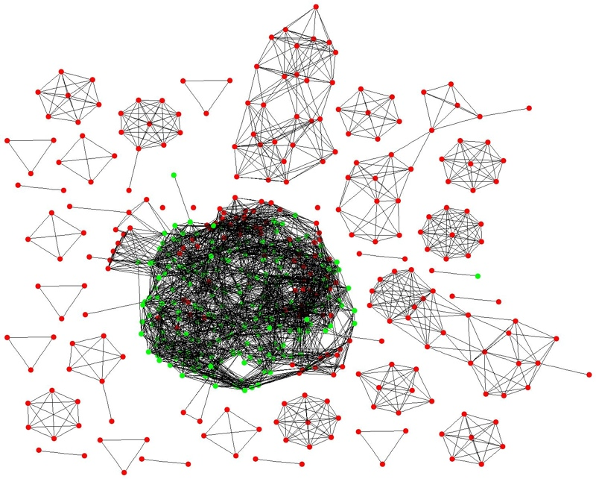
Cycle 220: Cooperation Emerges

Slide 42
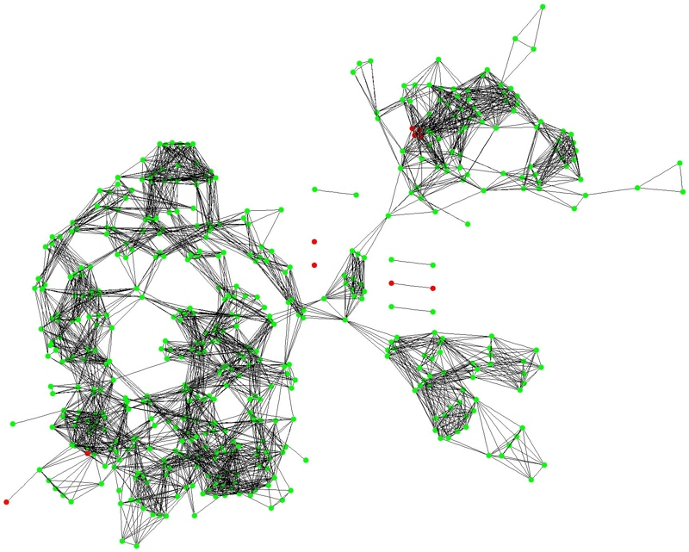
Cycle 230: Coop. Cluster Starts to Break Apart

Slide 43
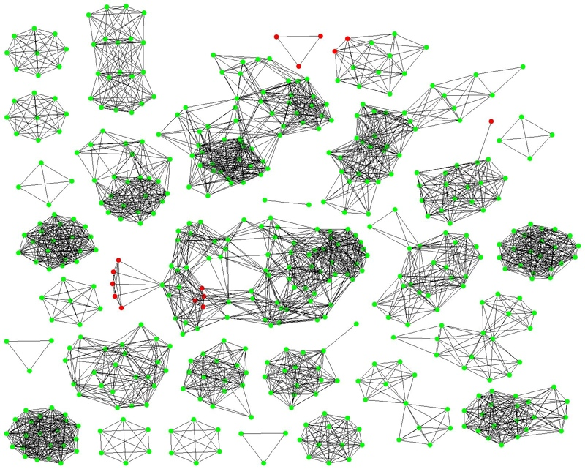
Cycle 300: Defect Nodes Isolated, Small Cooperative Clusters Formed

Slide 44
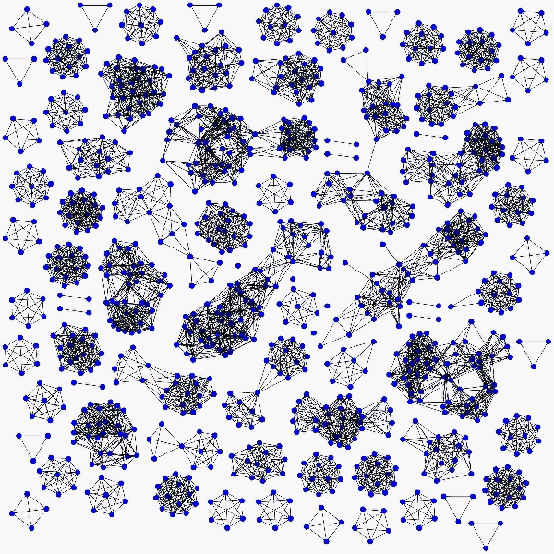

Slide 45
Rethinking “incentives” in individual v. collective dilemmas
Choreographer João Fiadeiro in developing collective improvisation method:
  Central control limits individual creativity
  Complete individual self-expression leads to ego driven incoherence
Develops and teaches a method called Real Time Composition
An interesting take on incentives

Slide 46
Real Time Composition
There is no a priori known collective or individual goal
No apparent utility or incentive structure
Through application of a method (a set of rules of thumb that individuals follow)
Collectively good outcomes often emerge
It can be viewed as a kind of socio-cognitive stigmergy based on following the rules of thumb

Slide 47
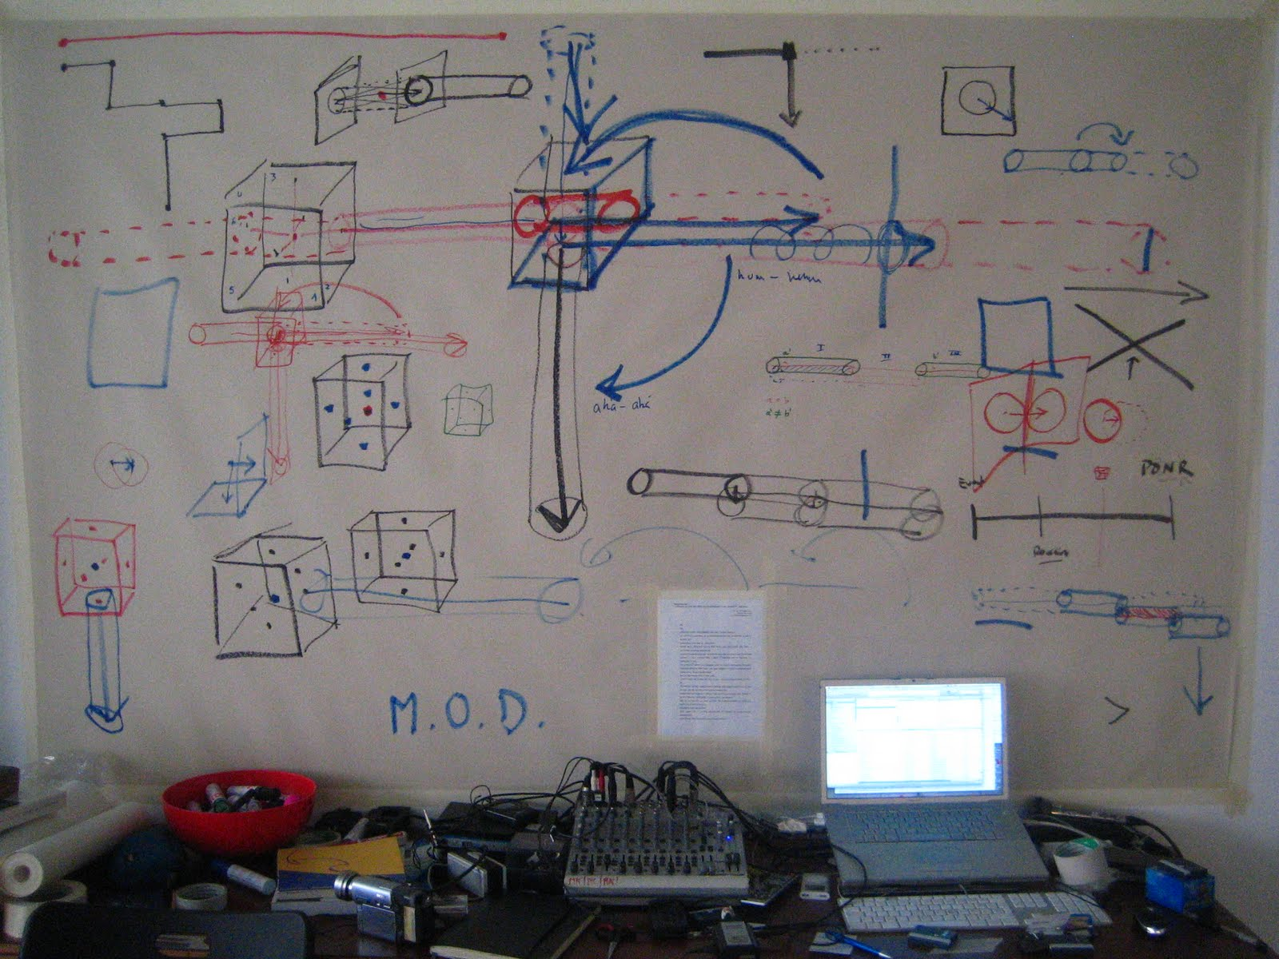
What are the “rules of thumb” of the method?

Slide 48
What are the rules of thumb?
It’s complex and evoloving but here is my take on the flavour:
Observe the environment carefully
Suppress desire to act spontaneously (not to act is also to act)
Consider at least 4 actions you can take and consider each in relation to the existing environment
Your action may:
  reinforce (copy / add to / continue) an existing pattern in the environment (evidenced from at least two previous actions)
  Begin a pattern suggested by a first action (make a second action)
  Start a new action
Try to make actions clear to observers of the environment
Try to avoid starting a new action unless the environment suggests it: such as looping or a physical constraint
Be creative in continuing a pattern with the materials available and the environmental constraints
Limit your communication to actions within the environment

Slide 49
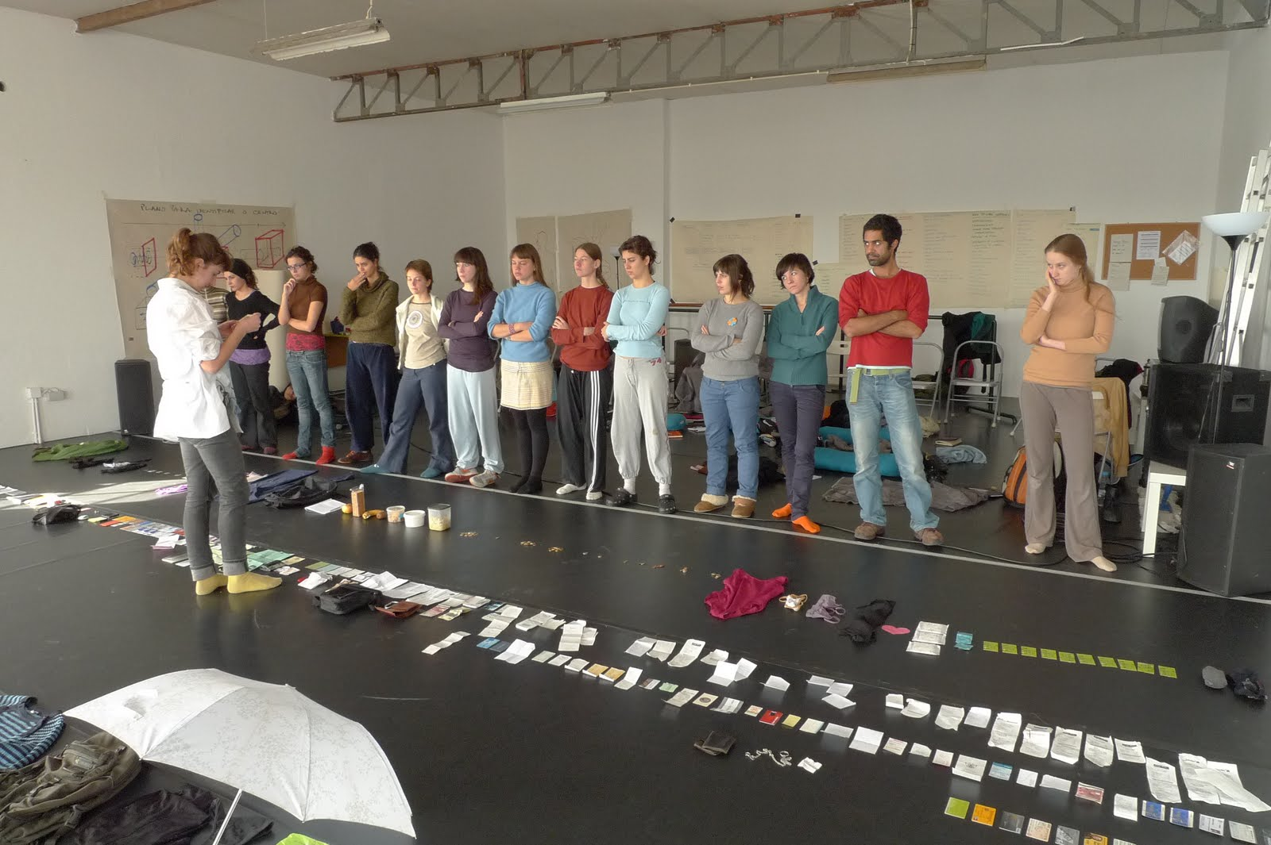

Slide 50
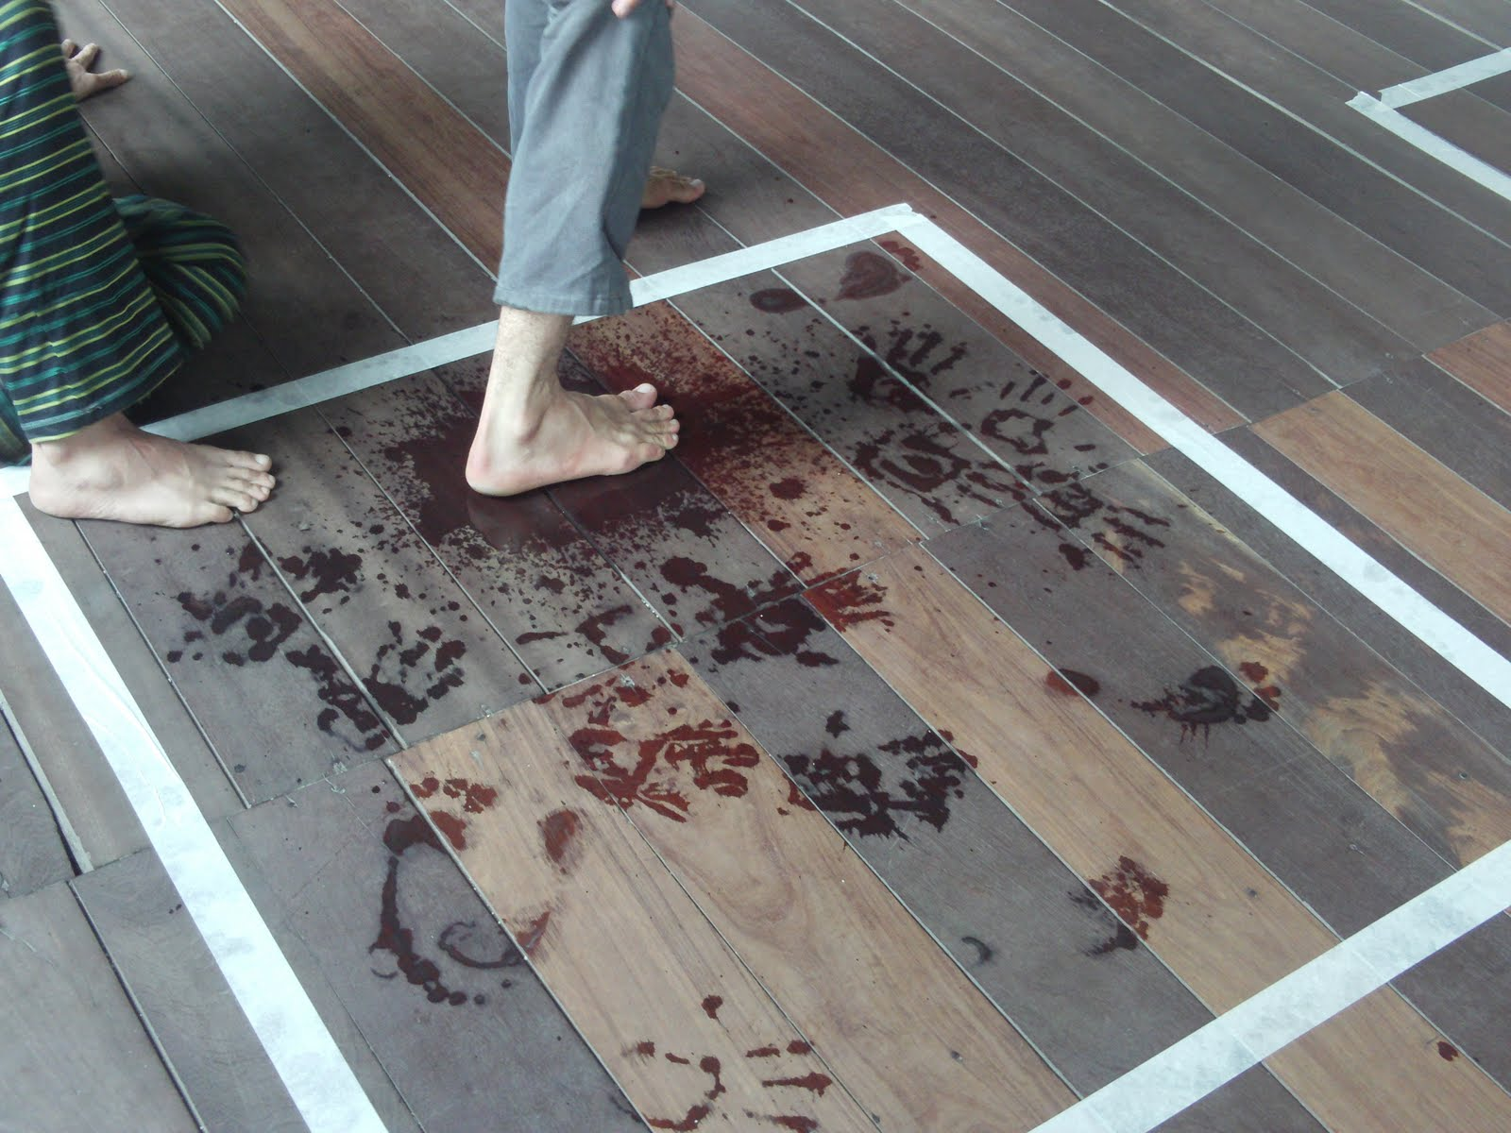

Slide 51
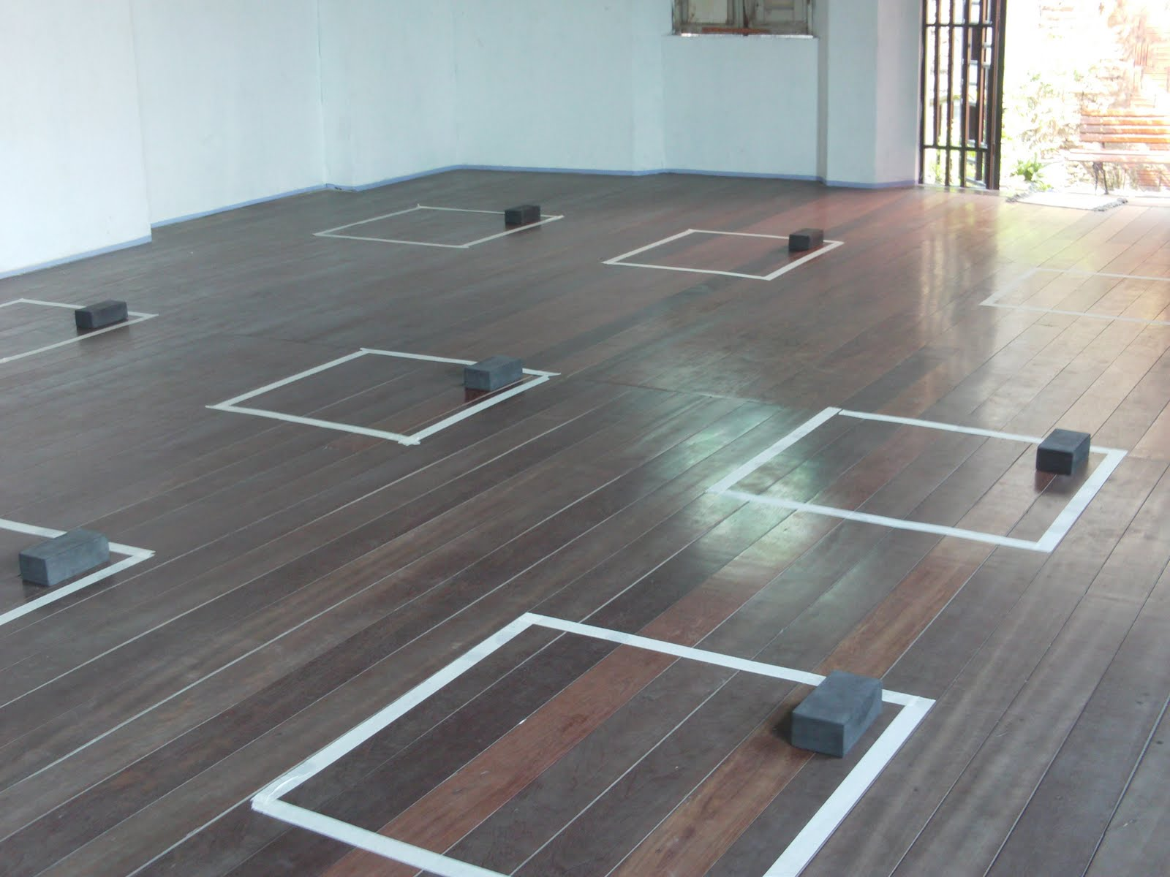

Slide 52
AND_Lab
João is currently running a project called AND_Lab (Artistic Research and Scientific Creativity) in collaboration with Fernanda Eugénio (an anthropologist):
http://and-lab.blogspot.com/

Slide 53
Creating tools not incentives?
In general I see a trend:
A focus away from incentives, rationality and / or central control to…
providing tools allowing people to create groups with structured interactions
Monitoring and communication via a shared environment
Collective goods (commons based peer production - Benkler)

Slide 54
Briefly…
Twitter and the “Arab Spring”. Too much has been said already.
Greek indignados – are they calling for a new government?
Wikileaks. A tool for crowd sourcing intelligence analysis? Trying again with twitter.
Avaaz.org – political lobbying
London riots. BBM used by self-organised groups to go looting?

Slide 55
New tools emerging – fighting corruption
Crowd source anonymously knowledge linking influential people in official positions
Potentially identify conflicts of interest
Influencenetworks.org

Slide 57
New tools emerging – open source currencies
Groups create their own currencies
Various policies and technologies
Two on-going projects:
  BitCoin (community gold function)
  Ripple (community bank function)

Slide 58
What “social transformation” are you talking about?
Move away from individualism in the form of markets / game theory type rational approaches
Move away from state-level collective planning and state actors generally
More focus on self-organising groups generating their own organisational / governance structures (“polycentric governance”)

Slide 59
What is my role in this?
We need new models to understand how to design new tools for group coordination
Not market / game theory OR central control (Agent-based modelling)
Such models will be significant in shaping the future (even if you don’t think they will be)
Already lots of work drawing on new sources of data harvested from existing social tools
You have a role because not acting is also acting

Slide 60
Questions?
www.davidhales.com

