Slide 1
Denationalisation of money: can quality emerge?
David Hales, Jeff Johnson
The Open University, UK
www.davidhales.com

Slide 2
What is money?
Not entirely clear what it is or where it came from but has definite functions:
  Store of value
  Transmission of value
  Unit of account
  Facilitate exchange
“a medium for the communication of value over space and time”

Slide 3
Quality Money
Useful to have quality money (eternal coin):
  Stable (value over time)
  Universal (acceptable everywhere)
  Fungible (one unit the same as any other)
  Fair (does not benefit one group over others)
  Secure (can’t easily be stolen)
  Convenient (can be moved around easily)

Slide 4
Nation State Money
Issued by central authorities (central banks)
additional money loaned into existence by local banks (credit creation)
Fiat – not backed by any commodity (in past gold was used for example)

Slide 5
The Problem
Not ideal because:
  Historically value declines (inflation)
  Different nations use different currencies
  Fiscal / monetary policy tangled
  Currency wars
  Trust in governments and banks declining

Slide 6
Solution: National World Currency
Select an existing national currency and make it a world reserve currency (US dollar)
Problem: National monetary policy may conflict with global liquidity requirements
  “The Triffin Dilemma, i.e., the issuing countries of reserve currencies cannot maintain the value of the reserve currencies while providing liquidity to the world, still exists.”
(Dr Zhou Xiaochuan, Governor of the People’s Bank of China, 23 March 2009)

Slide 7
Solution: Global Currency
Create a currency based on a “basket” of existing national currencies and / or commodities issued by a supranational body (e.g. IMF SDR’s, Bancor concept)
Problem: Still based on national currencies. Unlikely to be usable by “man in the street”.
“The reform should be guided by a grand vision and begin with specific deliverables. It should be a gradual process that yields win-win results for all”
(Dr Zhou Xiaochuan, Governor of the People’s Bank of China, 23 March 2009)

Slide 8
Solution: Global Currency
Create a world central bank issuing it’s own currency that everyone uses.
Problem: What nation will agree to this? Who decides policy? Would this not require world fiscal as well as monetary union? Democracy?
  “a new world money… will be issued against the total purchasable output of the community in return for the workers' services to the community. There will be no more reason for going to the City for a loan than for going to the oracle at Delphi for advice about it.”
  (H. G. Wells, “The New World Order”, 1940.)

Slide 9
Solution: Denationalise Money
Eliminate nation state role in monetary affairs by allowing anyone to issue money and sell it on the market. Choice, competition, Decentralise.
Problem: Assumes market is efficient. Requires trusted profit driven (corporate) authorities. Monopoly practices (google dollars, facebook credits).
“governments have become wholly inadequate for the task… and have incessantly and everywhere abused their trust to defraud the people” (F. A. Hayek, “The Denationalisation of Money: The Argument Refined”, 1990.)

Slide 10
Solution: Demarketise Money
Rather than trusting corporates create new competing fully decentralised open source (peer-to-peer currencies).
Problem: Who will administer / create them? Can they be secure? Will people trust them?
“What is needed is an electronic payment system based on cryptographic proof instead of trust, allowing any two willing parties to transact directly with each other without the need for a trusted third party.” (Satoshi Nakamoto, “Bitcoin: A Peer-to-Peer Electronic Cash System”, 2008)

Slide 11
P2P Open Source Currency
Similar to file sharing systems (like BitTorrent)
Fully decentralized no central trusted authority
Collectively “owned” and “controlled” by users
Cryptography provides security and privacy
Open source code provides transparency
Large design space of monetary policies possible

Slide 12
Example 1: BitCoin (bitcoin.org)
Analogous to “gold” – policy:
  There are a maximum number of bitcoins that can exist 21 million (8 decimal places granularity)
  Produced through “mining” CPU intensive search increases over time
All transactions broadcast to all nodes
If majority of CPU power in network runs protocol cheating is hard
Mining and potential transaction fees incentivise “good behavior”
Several exchanges, few traders accept, market CAP = $44m

Slide 14
Example 2: Ripple (Ripplepay.com)
Analogous to “bank credit” – policy:
  Anyone in the system can issue credit
  But only to trusted friends (social network)
  Several units of account (incl. bitcoin)
Security and incentives based on existing trust
Early stage no full P2P implementation
No traders or exchanges

Slide 15
Problems…
No single policy or software implementation will work for all people, time and places
But given a sufficient ecology of competing systems…
New systems can emerge, hacked or less useful systems will dissolve
Hacked systems introduce a new kind of Gresham's law
Competition between systems can drive cooperation within them: group selection

Slide 16
Problems…
Each P2P currency is an island (rather like a nation) in which value is trapped
Requires trusted 3rd parties to provide exchanges to allow for movement of value
Fully distributed P2P exchanges?
Some attempt:
  https://github.com/macourtney/Dark-Exchange

Slide 17
Solutions?
Assuming open source P2P:
  Healthy ecology of completing currencies
  Liquid exchanges
Could we borrow an idea from the Chinese central bank?
A composite currency based on a basket of popular P2P currencies
Using open source algorithm to constantly rebalance basket to maintain value

Slide 18
Agent-based models?
Group selection models may be adapted where:
  Group = agents holding currency
  Cooperation = behaviour that maintains value of currency
  Defection = behaviour that inflates or deflates value (including hacking)
  Under assumption that agents are boundedly rational copiers of others

Slide 19
A “sparkling” economy
Even an ecology of constantly forming and bursting bubbles “a sparkling economy”
Might produce stable value given a sufficiently “cleaver” algorithm
But no algorithm can know the future for sure
Could we evolve them in simulation?
A task for NESS?

Slide 20
Questions?
Some References:
[1] John F. Nash, “Ideal Money”, Southern Economic Journal, 2002, 69(1). http://www.jstor.org/pss/1061553
[2] H. G. Wells, “The New World Order”, 1940. http://gutenberg.net.au/ebooks04/0400671h.html
[3] People's Bank of China, "Reform the Int. Monetary System", March 2009. http://is.gd/0OhCmS
[4] F. A. Hayek, “The Denationalisation of Money: The Argument Refined”, 1990. http://mises.org/books/denationalisation.pdf
[5] The Economist, Jun 13th 2011. http://www.economist.com/blogs/babbage/2011/06/virtual-currency
[6] Victor Grishchenko, “Bitcoin?”, May 12th 2011. http://www.pds.ewi.tudelft.nl/~victor/bitcoin.html
[7] Gresham’s Law - http://en.wikipedia.org/wiki/Gresham's_law

Slide 21
Finish

Slide 22
P2P money
Using a social network of trusted friends
Each person can apply a credit level to each link in any monetary unit
Payments between nodes (value transfer) involves the system finding a route of credit between nodes
Depends on trust and enough back-to-back transfers to balance over time
Compare to Hawala system and other “informal value transfer” IVT, systems

Slide 23
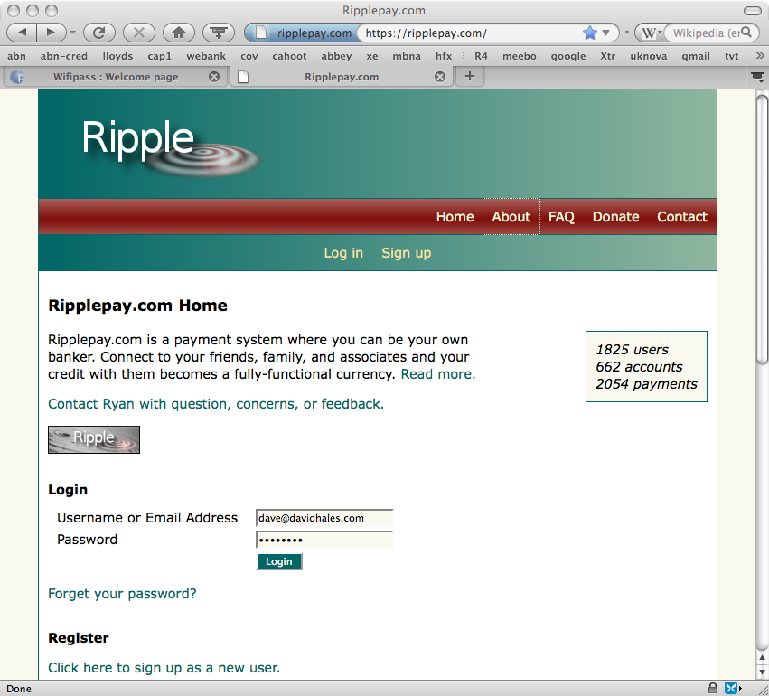

Slide 24
P2P Money
Currently know of no widely used deployed system (but BitCoin gaining ground)
Bootstrapping problem - possible way forward:
  Create a p2p virtual currency in a virtual game world with existing social networks
  Take detailed measurements and collect data
  See if it works and produce models
  If successful grow the currency outside the virtual game

Slide 25
BitCoin
P2P fully distributed crypto-currency
Distributed database of all transaction (transparency)
Various anti-attack mechanisms
No central control = should be hard to shutdown
New coins issued in a controlled and distributed way
Seems to be in a speculative bubble right now

