Slide 1

BitTorrent or BitCrunch:
Evidence of a credit squeeze in BitTorrent?
www.triber.org
David Hales, Rameez Rahman, Boxun Zhang, Michel Meulpolder, Johan Pouwelse,
Tribler group, Technical University of Delft, Netherlands.
COPS Workshop @ WETICE 2009, Groningen, 29/06/09

Slide 2
Public Trackers
BitTorrent uses Trackers to index swarms
Public trackers let anyone join a swarm
Sharing is incentivised via a form of tit-for-tat
However there is no incentive for:
  Seeding (uploading after file is downloaded)
  Capping (creating and injecting a new file)

Slide 3
Private Trackers
Private Trackers have emerged more recently
Only allow registered users to join swarms
Track upload / download of each user
Keep centralised accounts for each user
When users download much more than upload they may be kicked out
Different schemes: ratio, credits, points etc

Slide 4
Private Trackers - Credit
Consider a scheme based on credits
  Uploading 1MB earns one credit
  Downloading 1MB costs one credit
  A user with no credits can’t download
Users must be given some initial credit
In fixed size pop. total credit remains constant
Similar to a fixed supply of money in an economy (loose analogy!)

Slide 5
Private Trackers - Credit
How much credit should be put into the system?
How would it effect the efficiency of the system?
When do credit squeezes occur?
How can they be avoided?
We define a credit squeeze as a situation in which,
due to lack of credit, the efficiency of the system is
significantly reduced.

Slide 6
BitCrunch Model
Highly abstract and simplified model
  All nodes have equal upload / download
  Equally interested in all swarms on the tracker
  Always uploading to one swarm (seeding)
  Always downloading from another swarm (leeching)
  No modelling of tit-for-tat or free-riding
  Always online, fixed population
  If run out of credit (broke) must wait until earns some via upload before being allowed to download
  Swarms assumed to share upload “perfectly”

Slide 7
BitCrunch Model – baseline runs
Parameters:
  500 peers, 100 swarms
  Peer upload and download capacity = 1 unit
  Each file shared in each swarm = 10 units size
  One simulation cycle = each swarm processes one unit of time
  Run for 20,000 cycles (x10 runs)
  For initial credit per peer of 1, 10 and 100 units

Slide 8
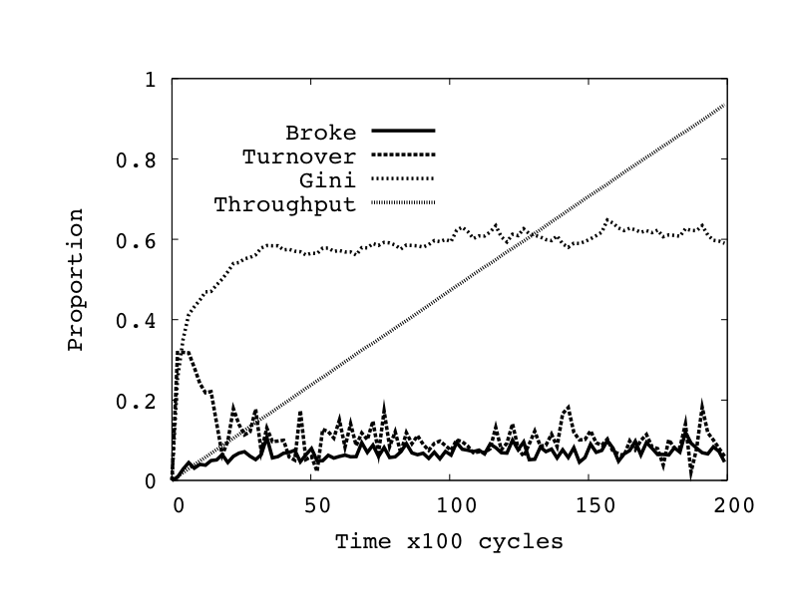
Typical basline simulation run
Initial Credit = 100

Slide 9
Baseline simulation results
C = initial credit
T = total throughput = total number of units uploaded as proportion of maximum possible (infinite credit)
B = proportion of nodes that are “broke” (zero credit)
G = Gini measure (simple measure of inequality of credit)
Phi = turnover of top 10% of peers ranked by credit (credit mobility)

Slide 10
Unequal capacities runs
To determine what happens when some nodes of different upload capacities
Parameters (same as baseline runs but):
  All peers download capacity = 10 units
  10% of peers upload capacity = 10 units
  90% of peers upload capacity = 1 unit
  Examined a (1.5 credit) seeding bonus approach to dynamically introduce more credit into the system

Slide 11
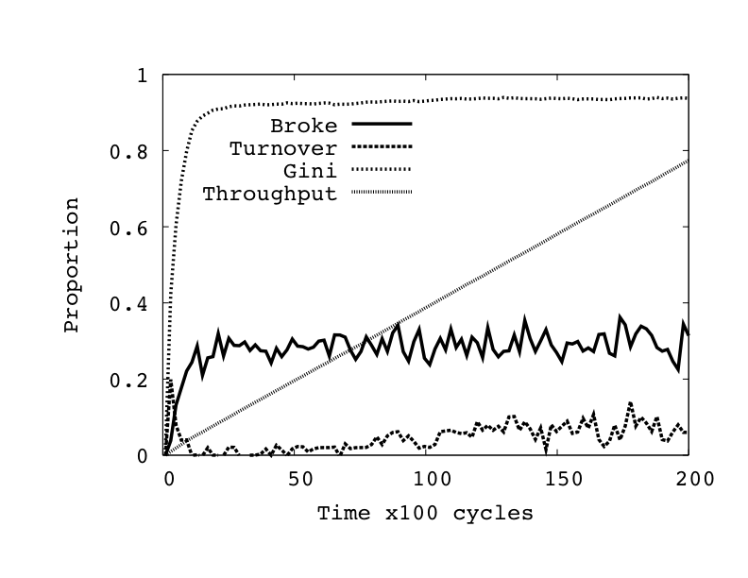
Typical unequal capacities run
Initial Credit = 100

Slide 12
Unequal capacities simulation results
0.06
C = initial credit
T = total throughput = total number of units uploaded as proportion of maximum possible (infinite credit)
B = proportion of nodes that are “broke” (zero credit)
G = Gini measure (simple measure of inequality of credit)
Phi = turnover of top 10% of peers ranked by credit (credit mobility)
100++ indicates initial credit of 100 with 1.5 credit seeding bonus

Slide 13
Observations
Even in a trivial model where all peers have the same capacities and user behaviour, all swarms have equal popularity and all peers start with equal credits, the performance of the system may be inhibited by credit shortages

Slide 14
Observations
Adding extra capacity to the system, in the form of upload and download, can actually reduce the performance. This is highly counter intuitive and something that should be avoided because it implies lack of scalability.

Slide 15
Observations
By injecting new credit into the system in the form of a ``seeding bonus’’ a credit squeeze can be ameliorated when peer capacities are unbalanced.

Slide 16
Statistics from a Private Tracker
Approx. 50,000 peers per day, 10,000 swarms,
access to credit balances of top 10%
T = throughput in TB over all swarms
Delta = total credit increase that day in the entire system
Delta0 = total credit increase for top 10% of peers
Delta = minimum fraction of credit increase that goes to top 10% of peers
S/L = seeder to leecher ratio over all swarms

Slide 17
Statistics from a Private Tracker
Indicates “rich getting richer” since top 10% are getting a lot of the new credit
High Seeder / Leecher ratio suggestive that a credit squeeze is happening for many
But need more information to verify this
Would be interesting to see what happened to throughput if there was a “free day” or seeding bonus was increased

Slide 18
Conclusions
Private trackers using “ratio enforcement” policies appear to be ad-hoc and various
But can have dramatic effects on efficiency
Too much credit could encourage free-riding
Too little creates squeezes = lower efficiency
These are just initial investigations
Much more work needs to be done!

Slide 19
Advert / plug / shameless promotion!
Download tribler 5.1 at: www.tribler.org
Comments / discussion and suggestions on:
forum.tribler.org

